Slide 1
Introduction
to
Neo4j Graph Data Modeling
V 1.1

Slide 2
Welcome everyone We will start at 9 am
To Do if Not Done Already:
Install Neo4j Desktop from neo4j.com/download
- If local desktop install is problematic -
Create Sandbox on neo4j.com/sandbox
Introduction to Neo4j Graph Data Modeling Training
2020.04.23
Alex Rivilis & Vik Malhotra
Notes:
I

Slide 3
Your “friendly” Instructors Alex Rivilis and Vik Malhotra Solution Engineers
at Neo4j Inc.
alex.rivilis@neo4j.com vik.malhotra@neo4j.com

Slide 4
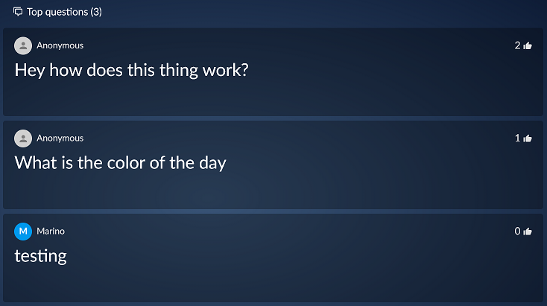

Sli.do for in-class interactive Q&A
Via computer: Visit www.sli.do
Via Mobile: Use QR code #45527
Please add your name! Anonymous is also an option.
Submit questions, ‘like’ 👍 questions already submitted
Neo4j team will answer questions in-line when possible
We will review Sli.do Q&A at set points during the class
e.g. after exercises or before/after breaks
For pressing or timely questions, please speak up rather than using Sli.do

Slide 5
Our Plan for Today
Agenda
Introduction and Recap of Neo4j Introduction class on April 21st
Building the Initial Model
Graph Modeling Core Principles
Common Graph Structures
Refactoring & Evolving a Data Model
Implementing Your First Model
Importing Bulk Data
Implementing a Refactor
Objectives & Outcomes
Install and run Neo4j locally
Core Modeling Principles and Graph Structures
Refactoring & Evolving a Data Model
Know where to go next..

Slide 6
Lets Go!

Slide 7
Introduction to
Graph Data Modeling
for Neo4j
v 1.0

Slide 8
Review:
the Neo4j Property Graph
Notes:
Demonstrate the functionality of Arrow Tool. Invite students to follow along with you.
http://www.apcjones.com/arrows
Do all of the following:
Create the Dan-Ann-Residence model, as on the previous slides.
Export a model (copy)
Clear the model
Import a model (paste)
************
Go to www.apcjones.com/arrows
Add a node: Click +Node.
Double-click the node.
You are now in the Edit Node pane.
Enter:
Caption: Person
Properties:
name: 'Dan'
born: 1975
Click Save.
You should now see the node.
Add another node: Click +Node.
Double-click the node.
You are now in the Edit Node pane for the node.
Enter:
Caption: Person
Properties:
name: 'Ann'
born: 1977
Click Save.
Both nodes now appear. Arrange them as you like.
Add the MARRIED relationship between Dan and Ann: Hover over the outside of the 'Dan' node and drag its halo to the halo of the 'Ann' node.
The arrow should appear. Double-click the arrow.
You are now in the Edit pane for the relationship.
Enter:
Type: MARRIED
Properties:
since: 2005-02-14
Click Save.
Click +Node.
Double-click the node.
You are now in the Edit Node pane.
Enter:
Caption: Person
Properties:
name: 'Dan'
born: 1975
Click Save.
The nodes and relationship should appear.
Add a node: Click +Node.
Double-click the node.
You are now in the Edit Node pane.
Enter:
Caption: Residence, Location
Properties:
address: '475 Broad Street'
postalCode: 28394
Click Save.
The new node should appear. Arrange the nodes as you like.
Add the LIVES_AT relationship between Dan and the Residence node: Hover over the outside of the 'Dan' node and drag its halo to the halo of the Residence node.
The arrow should appear. Double-click the arrow.
You are now in the Edit pane for the relationship.
Enter:
Type: LIVES_AT
Click Save.
You should now see the relationship. Arrange the nodes as you want to.
Add the LIVES_AT relationship between Ann and the Residence node: Hover over the outside of the 'Ann' node and drag its halo to the halo of the Residence node.
The arrow should appear. Double-click the arrow.
You are now in the Edit pane for the relationship.
Enter:
Type: LIVES_AT
Click Save.
You should now see the relationship. Arrange the nodes as you want to.
Add the OWNS relationship between Ann and the Residence node: Hover over the outside of the 'Ann' node and drag it to the outside of the Residence node.
The arrow should appear. Double-click the arrow.
You are now in the Edit pane for the relationship.
Enter:
Type: OWNS
Properties:
financed: TRUE
Click Save.
You should now see the the completed graph data model. Arrange the nodes as you want to.
Show how to use the slider for Internal scale.
Click Export Markup to show how the model is implemented in markup.
Show that you can cut out the middle of the model to clear the display. You can save the markup in a text file.
Show that you can also export the SVG file if you want show your model to somebody who is not using the Arrow Tool or if you want to include it in a document.

Slide 9


Property Graph elements
since: 2005-02-14
name: ‘Dan’
born: 1975
MARRIED
name: ‘Ann’
born: 1977
Nodes (Entities)
Relationships
Properties
Labels
Person
Person
LIVES_AT
LIVES_AT
OWNS
financed=TRUE
Location
Residence
address: ‘475 Broad Street’
postalCode: 28394
Notes:
On this slide, do a Concept Check. Ask questions like:
What information can be attached to a node? Which of these are required?
Labels & properties. None required
What information can be attached to a relationship? Which of these are required?
Direction, type, and properties. Direction and type required.
What is the difference between a label and property?
Labels are categorical. Properties are specific.
<ul class="graph-diagram-markup" data-internal-scale="1.22" data-external-scale="1">
<li class="node" data-node-id="0" data-x="-287.943080214204" data-y="109.65294759781544">
<span class="caption">Person</span><dl class="properties"><dt>name</dt><dd>'Dan'</dd><dt>born</dt><dd>1975</dd></dl></li>
<li class="node" data-node-id="1" data-x="92.51136654713098" data-y="-272.3630010886265">
<span class="caption">Person</span><dl class="properties"><dt>name</dt><dd>'Ann'</dd><dt>born</dt><dd>1977</dd></dl></li>
<li class="node" data-node-id="2" data-x="465.7443079806508" data-y="109.65294759781544">
<span class="caption">Residence, Location</span><dl class="properties"><dt>address</dt><dd>'475 Broad Street'</dd><dt>postalCode</dt><dd>28394</dd></dl></li>
<li class="relationship" data-from="0" data-to="1">
<span class="type">MARRIED</span><dl class="properties"><dt>since</dt><dd>2005-02-14</dd></dl></li>
<li class="relationship" data-from="0" data-to="2">
<span class="type">LIVES_AT</span>
</li>
<li class="relationship" data-from="1" data-to="2">
<span class="type">LIVES_AT</span>
</li>
<li class="relationship" data-from="1" data-to="2">
<span class="type">OWNS</span><dl class="properties"><dt>financed</dt><dd>TRUE</dd></dl></li>
</ul>

Slide 10
Traversal
since: 2005-02-14
name: ‘Dan’
born: 1975
MARRIED
name: ‘Ann’
born: 1977
Anchor & expand
Uniqueness (trails)
Person
Person
LIVES_AT
LIVES_AT
OWNS
financed=TRUE
Location
Residence
MATCH (r:Residence)<-[:OWNS]-(p)
WHERE r.address = '475 Broad Street'
RETURN p
address: ‘475 Broad Street’
postalCode: 28394
Notes:
On this slide, do a Concept Check. Ask questions like:
What uniqueness limitations does Cypher enforce?
A query can visit a node any number of times. but can traverse each relationship only than once
Given a Cypher query, how does Neo4j decide where to begin traversing?
Neo4j will predict which of the node sets in the query is smallest. It will begin there. In this case, r is likely to be smallest, as it has a property filter.

Slide 11
Using Arrows to
whiteboard a data model
Notes:
Demonstrate the functionality of Arrow Tool. Invite students to follow along with you.
http://www.apcjones.com/arrows
Do all of the following:
Create the Dan-Ann-Residence model, as on the previous slides.
Export a model (copy)
Clear the model
Import a model (paste)
************
Go to www.apcjones.com/arrows
Add a node: Click +Node.
Double-click the node.
You are now in the Edit Node pane.
Enter:
Caption: Person
Properties:
name: 'Dan'
born: 1975
Click Save.
You should now see the node.
Add another node: Click +Node.
Double-click the node.
You are now in the Edit Node pane for the node.
Enter:
Caption: Person
Properties:
name: 'Ann'
born: 1977
Click Save.
Both nodes now appear. Arrange them as you like.
Add the MARRIED relationship between Dan and Ann: Hover over the outside of the 'Dan' node and drag its halo to the halo of the 'Ann' node.
The arrow should appear. Double-click the arrow.
You are now in the Edit pane for the relationship.
Enter:
Type: MARRIED
Properties:
since: 2005-02-14
Click Save.
Click +Node.
Double-click the node.
You are now in the Edit Node pane.
Enter:
Caption: Person
Properties:
name: 'Dan'
born: 1975
Click Save.
The nodes and relationship should appear.
Add a node: Click +Node.
Double-click the node.
You are now in the Edit Node pane.
Enter:
Caption: Residence, Location
Properties:
address: '475 Broad Street'
postalCode: 28394
Click Save.
The new node should appear. Arrange the nodes as you like.
Add the LIVES_AT relationship between Dan and the Residence node: Hover over the outside of the 'Dan' node and drag its halo to the halo of the Residence node.
The arrow should appear. Double-click the arrow.
You are now in the Edit pane for the relationship.
Enter:
Type: LIVES_AT
Click Save.
You should now see the relationship. Arrange the nodes as you want to.
Add the LIVES_AT relationship between Ann and the Residence node: Hover over the outside of the 'Ann' node and drag its halo to the halo of the Residence node.
The arrow should appear. Double-click the arrow.
You are now in the Edit pane for the relationship.
Enter:
Type: LIVES_AT
Click Save.
You should now see the relationship. Arrange the nodes as you want to.
Add the OWNS relationship between Ann and the Residence node: Hover over the outside of the 'Ann' node and drag it to the outside of the Residence node.
The arrow should appear. Double-click the arrow.
You are now in the Edit pane for the relationship.
Enter:
Type: OWNS
Properties:
financed: TRUE
Click Save.
You should now see the the completed graph data model. Arrange the nodes as you want to.
Show how to use the slider for Internal scale.
Click Export Markup to show how the model is implemented in markup.
Show that you can cut out the middle of the model to clear the display. You can save the markup in a text file.
Show that you can also export the SVG file if you want show your model to somebody who is not using the Arrow Tool or if you want to include it in a document.

Slide 12
Video Demonstration: https://www.youtube.com/watch?v=NB184T-S46w

Slide 13
What is graph data modeling?
Collaborative effort where the application domain is analyzed by stakeholders and developers to come up with the optimal model for use with Neo4j.
Who are the stakeholders?
Business analysts
Architects
Managers
Project leaders
Notes:
Semantics of what the data means and the structure which represents the semantics.
Analysts who will use it
Architects who will build it
Manager who will act upon the data
Project leaders and any number of people

Slide 14

Graph data modeling workflow
Step | Description | Stakeholders | Developers
1. | Define the initial graph data model
2. | Create and profile Cypher queries to support the model
3. | Create data in the database to support the model
4. | Identify additional questions for the application
5. | Modify the graph data model to support new questions
6. | Refactor the database to support the revised graph data model
7. | Create and profile Cypher queries to support the revised model
 | Repeat Steps 4-7
Notes:
Emphasize that data model maintenance is cyclical and iterative. We are comfortable with this idea because updating a graph model is much cheaper and easier than updating the schema of a tabular store. Ease-of-updating will be a consistent theme throughout the Data Modeling course.

Slide 15
Thank you!

Slide 16
Building an Initial Model

Slide 17
Building the initial data model
Understand the domain
Create sample data
Define specific questions for the application
Identify entities
Identify connections between entities
Test the questions against the model
Test scalability
Notes:
Building the initial model is a multi-step process. We find it is extremely important to be disciplined about this. If you do, you tend to get to a first model faster, that model better suits your documented needs, and that model is usually simple to understand. It will almost certainly not be perfect, and will need to change in response to shifting needs and a deepening understanding of the domain, use case, and capabilities of Neo4j. But recall that modifying a data remodel in Neo4j is relatively inexpensive. This fact reduces the pain and risk of taking a narrow approach to the first model. Later in this course, we will discuss how to identify weaknesses in a model, and how to improve the existing design.
********** If asked: every organization has their own standards for how requirements are documented. We will not be teaching how to document requirements, but rather focus on the model itself.

Slide 18
Understanding the domain
Description of the application
Identify stakeholders, developers
Identify users of the application (people, systems)
Enumerate the use cases that are agreed upon by all stakeholders where users are part of the use case
Notes:
No knowledge of the underlying implementation!
Base use cases or money queries that no matter what you add functionality you do not compromise these base use cases.

Slide 19
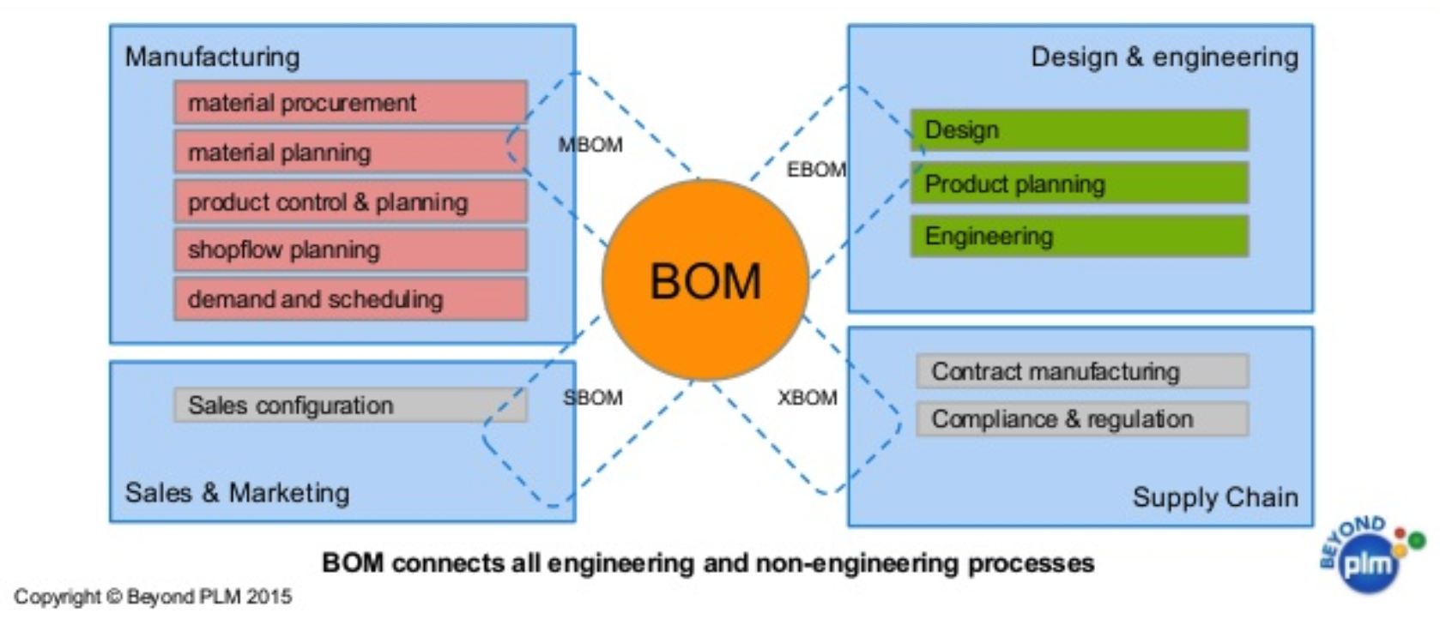
Example domain: Bill of Materials
Notes:
From Wikipedia:
Commonly seen in manufacturing,
A bill of materials or product structure (sometimes bill of material, BOM or associated list) is a list of the raw materials, sub-assemblies, intermediate assemblies, sub-components, parts, and the quantities of each needed to manufacture an end product.
A BOM may be used for communication between manufacturing partners or confined to a single manufacturing plant. A bill of materials is often tied to a production order whose issuance may generate reservations for components in the bill of materials that are in stock and requisitions for components that are not in stock.
A BOM can define products as they are designed (engineering bill of materials), as they are ordered (sales bill of materials), as they are built (manufacturing bill of materials), or as they are maintained (service bill of materials).
The different types of BOMs depend on the business need and use for which they are intended.
In process industries, the BOM is also known as the formula, recipe, or ingredients list.
The phrase "bill of material" (or "BOM") is frequently used by engineers as an adjective to refer not to the literal bill, but to the current production configuration of a product, to distinguish it from modified or improved versions under study or in test.

Slide 20
Common BOM use cases
System produces list of parts to make a product
System produces list of products that can be made with available parts
System produces list of parts that are made with other parts.
User picks parts to make a product
System creates a price for a product based upon the part prices
System creates list of parts that need to be ordered
Notes:
A product or part can be made of multiple parts of the same type
Some parts are made from other parts (sub-assembly)
Notes:
This is a very small fraction of the use cases for the BOM application.

Slide 21
Building the initial data model
Understand the domain
Create sample data
Define specific questions for the application
Identify entities
Identify connections between entities
Test the questions against the model
Test scalability
Notes:
Sample data need not be expansive, detailed, or even of particularly high quality. It simply needs to represent the broad shape of the information you would expect to find in the real data. Sample data can either be completely made up, or can be a sample pulled from a real dataset. If you’ve done the work to properly understand the domain, it should not strongly matter either way.

Slide 22
BOM sample data
Products | Parts | Assemblies | Notes
Wood table 40" | Wood top 40" | Leg assembly | Has 4 legs
Deluxe wood table 40" | Wood top 40” or Glass top 40" | Leg assembly | Has 4 legs
Wood table 60" | Wood top 60" | Leg assembly | Has 6 legs, table brace
Deluxe wood table 60" | Wood top 60” or Glass top 60" | Leg assembly | Has 6 legs, table brace
 | Leg
 | Leg foot
 | M20 bolt
 | M20 nut
 | Leg plate |  | Uses 2 bolts/nuts per leg
 | Table brace |  | A table brace is only used for the 60" tables.
Notes:
If you want your modeling process to be constructive, you must have enough data points for your domain so that you can understand the data that will be retrieved when the questions are asked.
The data is typically the "things" described in the use cases. You don't include "system" or "user" as part of the data.
Note: A table brace is only used for the 60" tables.

Slide 23
Building the initial data model
Understand the domain
Create sample data
Define specific questions for the application
Identify entities
Identify connections between entities
Test the questions against the model
Test scalability

Slide 24
Sample questions for BOM
What parts are needed to make Wood table 40"?
Do we have enough parts to make 100 Deluxe wood table 60"?
What products require a table brace?
How much will the parts cost to make product Wood table 60"?

Slide 25
Building the initial data model
Understand the domain
Create sample data
Define specific questions for the application
Identify entities
Identify connections between entities
Test the questions against the model
Test scalability
Notes:
Questions identified is very important task because now u can get into identifying the entities.

Slide 26
Identify the entities from the questions
Nouns
Entities are the generic nouns (example: City)
Name the entities which will be nodes in the graph:
Unambiguous meaning for the name
Agreement by stakeholders
Can entities be grouped or categorized?
Pets, dogs, cats
Properties for the entities
Property value is a proper noun for the name of the entity (example: Boston)
Uniquely identify an entity
Used to describe the entity to answer questions (anchor for the query)
Notes:
Grouping entities is an optimization that is available in Neo4j (labels for nodes) which makes finding a node quicker.
Note: How uniqueness is used in the model is significant. You will see later in the course that the line1 and line2 of an address need to represent a unique node. For example 500 Main Street exists in many cities and you must add a property to the address to make it unique. (for example location (lat/long))

Slide 27
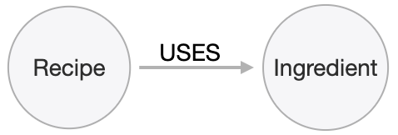
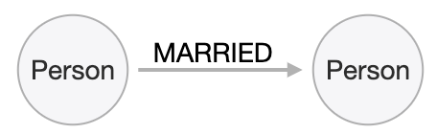
Identify entities from the questions
Entities are the nouns in your application questions
What ingredients are used in a recipe?
Who is married to this person?
The generic nouns will often become labels in your model
Use domain knowledge to decide if entities need to be further grouped or differentiated
Notes:
As an example of using domain knowledge, you might happen to know that the distinction between wet and dry ingredients is important in your use case,
or that vegetarian and vegan are important subgroups of recipe.
These may not appear clearly in the specific application questions.

Slide 28
Identify entities from the questions
Properties must serve one of two purposes
Unique identification
Answering one of the application questions
Anchoring
Navigation
Output
Otherwise, they are merely decoration
Notes:
Entities and Labels are only half the question, you also need to figure out what properties they might have:
Identifiers serve two purposes: they can be used to power unique constraints or MERGE functions, and they can be useful to help a human user understand what they are looking at in query outputs.
Properties used to answer questions can do one of three things:
they might be used as anchors, they could be used for navigation ( is a property that you check to see if the path that you are on is a good one or a bad one), and they can be used as outputs. There are subtly different best practices for properties serving each of those functions, which we will discuss in detail later. For now, we simply group them all into this one generic bucket of usefulness. Decorators should usually be left out of the initial model. If they aren’t being used to answer questions, they are a waste of storage, and their presence can distract users and developers from the information that is actually important. Remember that we endorse a narrow, focused approach to model building, based on the relative ease of modifying a graph data model.
Atleast for the initial model and testing decorators can be left out. However, it can be beneficial to include decorators when you move to production. Not because they will be used, but because, if all information is locally available to Neo4j, refactoring a model later may not require importing data from its original source.

Slide 29
Exercise 1:
Identify entities for the BOM application

Slide 30
Exercise 1: Application questions
What parts are needed to make Wood table 40"?
Do we have enough parts to make 100 Deluxe wood table 60"?
What products require a table brace?
How much will the parts cost to make product Wood table 60"?
Notes:
Prompt the students to identify the entities from these questions as a group. Direct them to find labels first. Then, go through the list of entities and ask for identifier and question-answering properties for each. If someone proposes a decorator, note it as such, and do not keep it.
If anyone start thinking about connections, remind them to stay narrowly focused on entities. Reinforce the importance of staying disciplined. ********* The final product should be similar to below. Assembly is the tricky one--it does not appear in the questions, and you must use domain knowledge to understand why it is needed. If anyone challenges the necessity of the Assembly entity, grant that they could well be right that it isn’t needed, but that we will see why it is useful a little later. Remind everyone that the first model is never perfect, and we’re OK with that because modifying it is relatively easy. Their model need not exactly match this one. Remember, the first model is never perfect. Highlight the strengths and weaknesses of their design choices later, when we start to evaluate the model against our questions.
Product
name
productID
Part
name
partNumber
price
Part, Assembly
name
partNumber
price

Slide 31
Exercise 1: Entities
Product
name
productId
Part
name
partNumber
price
Part, Assembly
name
partNumber
price

Slide 32
Exercise 2:
Create BOM entity model
in Arrows
Notes:
Invite everyone to create the BOM entities on their own in Arrows. Do this yourself also. For Properties, encourage folks to use “expected data type” as property values; e.g., integer, String, decimal, etc.
www.apcjones.com/arrows If you don’t want to do all the clicking and typing, copy this markup: <ul class="graph-diagram-markup" data-internal-scale="2.01" data-external-scale="1">
<li class="node" data-node-id="0" data-x="-106.54309068746238" data-y="-40.13742460863777">
<span class="caption">Part</span><dl class="properties"><dt>name</dt><dd>String</dd><dt>partNumber</dt><dd>integer</dd><dt>price</dt><dd>decimal</dd></dl></li>
<li class="node" data-node-id="1" data-x="-262.3812669868761" data-y="-40.13742460863777">
<span class="caption">Product</span><dl class="properties"><dt>name</dt><dd>String</dd><dt>productID</dt><dd>integer</dd><dt>price</dt><dd>decimal</dd></dl></li>
<li class="node" data-node-id="2" data-x="-202.58837695145493" data-y="24.371374691303693">
<span class="caption">Assembly, Part</span><dl class="properties"><dt>name</dt><dd>String</dd><dt>partNumber</dt><dd>integer</dd><dt>price</dt><dd>decimal</dd></dl></li>
</ul>

Slide 33
Exercise 2: Instructions
Go to http://www.apcjones.com/arrows.
Clear the graph data model.
Hint: Click Export Markup and delete all <li> entries, then click Save.
Create the nodes and properties for the Bill of Materials entities you identified earlier using the data in BOM-1.txt
Save the model as BOM-1.htm and BOM-1.svg
Notes:
Here is the SVG for the BOM-1 graph. Here we have created the Product and Part nodes with their properties. These nodes do not yet have relationships with each other.

Slide 34
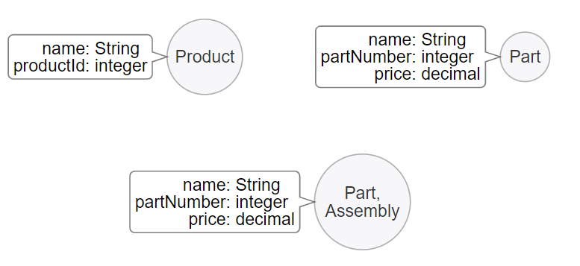
Exercise 2: Model
Notes:
This is the model example. The next slide shows the sample data built according to this entity model *********** Arrows markup: <ul class="graph-diagram-markup" data-internal-scale="0.75" data-external-scale="1">
<li class="node" data-node-id="0" data-x="34.677500089009605" data-y="0">
<span class="caption">Part</span><dl class="properties"><dt>name</dt><dd>String</dd><dt>partNumber</dt><dd>integer</dd><dt>price</dt><dd>decimal</dd></dl></li>
<li class="node" data-node-id="1" data-x="-141.37749989827472" data-y="157.3825028737386">
<span class="caption">Part, Assembly</span><dl class="properties"><dt>name</dt><dd>String</dd><dt>partNumber</dt><dd>integer</dd><dt>price</dt><dd>decimal</dd></dl></li>
<li class="node" data-node-id="2" data-x="-312.09750111897785" data-y="0">
<span class="caption">Product</span><dl class="properties"><dt>name</dt><dd>String</dd><dt>productId</dt><dd>integer</dd></dl></li>
</ul>

Slide 35
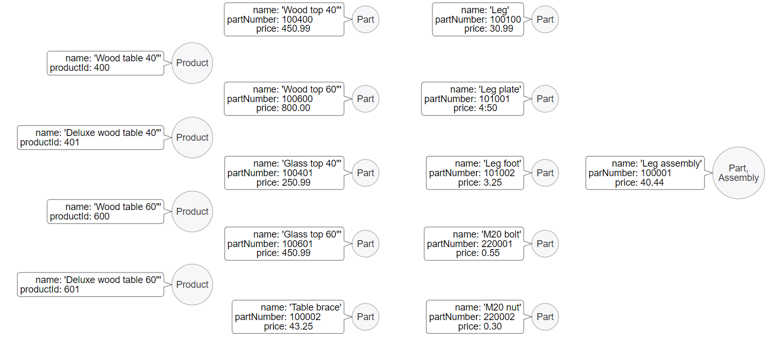
Exercise 2: Sample data
Notes:
If you apply the model to the sample data it would look like this.
This shows the sample data built according to our entity model. Arrows markup:
<ul class="graph-diagram-markup" data-internal-scale="0.75" data-external-scale="1">
<li class="node" data-node-id="0" data-x="-345.4412714640299" data-y="383.87709554036445">
<span class="caption">Product</span><dl class="properties"><dt>name</dt><dd>'Wood table 60"'</dd><dt>productId</dt><dd>600</dd></dl></li>
<li class="node" data-node-id="1" data-x="-345.4412714640299" data-y="236.10179201761875">
<span class="caption">Product</span><dl class="properties"><dt>name</dt><dd>'Deluxe wood table 40"'</dd><dt>productId</dt><dd>401</dd></dl></li>
<li class="node" data-node-id="2" data-x="-345.4412714640299" data-y="87.45419788360597">
<span class="caption">Product</span><dl class="properties"><dt>name</dt><dd>'Wood table 40"'</dd><dt>productId</dt><dd>400</dd></dl></li>
<li class="node" data-node-id="3" data-x="-345.4412714640299" data-y="529.8155937194823">
<span class="caption">Product</span><dl class="properties"><dt>name</dt><dd>'Deluxe wood table 60"'</dd><dt>productId</dt><dd>601</dd></dl></li>
<li class="node" data-node-id="4" data-x="0" data-y="0">
<span class="caption">Part</span><dl class="properties"><dt>name</dt><dd>'Wood top 40"'</dd><dt>partNumber</dt><dd>100400</dd><dt>price</dt><dd>450.99</dd></dl></li>
<li class="node" data-node-id="5" data-x="358.16830571492505" data-y="594.2919225692748">
<span class="caption">Part</span><dl class="properties"><dt>name</dt><dd>'M20 nut'</dd><dt>partNumber</dt><dd>220002</dd><dt>price</dt><dd>0.30</dd></dl></li>
<li class="node" data-node-id="6" data-x="0" data-y="594.2919225692748">
<span class="caption">Part</span><dl class="properties"><dt>name</dt><dd>'Table brace'</dd><dt>partNumber</dt><dd>100002</dd><dt>price</dt><dd>43.25</dd></dl></li>
<li class="node" data-node-id="7" data-x="743.9158417483172" data-y="306.76251220703097">
<span class="caption">Part, Assembly</span><dl class="properties"><dt>name</dt><dd>'Leg assembly'</dd><dt>parNumber</dt><dd>100001</dd><dt>price</dt><dd>40.44</dd></dl></li>
<li class="node" data-node-id="8" data-x="358.16830571492505" data-y="448.1400159200031">
<span class="caption">Part</span><dl class="properties"><dt>name</dt><dd>'M20 bolt'</dd><dt>partNumber</dt><dd>220001</dd><dt>price</dt><dd>0.55</dd></dl></li>
<li class="node" data-node-id="9" data-x="358.16830571492505" data-y="306.76251220703097">
<span class="caption">Part</span><dl class="properties"><dt>name</dt><dd>'Leg foot'</dd><dt>partNumber</dt><dd>101002</dd><dt>price</dt><dd>3.25</dd></dl></li>
<li class="node" data-node-id="10" data-x="358.16830571492505" data-y="158.7162431081135">
<span class="caption">Part</span><dl class="properties"><dt>name</dt><dd>'Leg plate'</dd><dt>partNumber</dt><dd>101001</dd><dt>price</dt><dd>4:50</dd></dl></li>
<li class="node" data-node-id="11" data-x="358.16830571492505" data-y="0">
<span class="caption">Part</span><dl class="properties"><dt>name</dt><dd>'Leg'</dd><dt>partNumber</dt><dd>100100</dd><dt>price</dt><dd>30.99</dd></dl></li>
<li class="node" data-node-id="12" data-x="0" data-y="448.1400159200031">
<span class="caption">Part</span><dl class="properties"><dt>name</dt><dd>'Glass top 60"'</dd><dt>partNumber</dt><dd>100601</dd><dt>price</dt><dd>450.99</dd></dl></li>
<li class="node" data-node-id="13" data-x="0" data-y="306.76251220703097">
<span class="caption">Part</span><dl class="properties"><dt>name</dt><dd>'Glass top 40"'</dd><dt>partNumber</dt><dd>100401</dd><dt>price</dt><dd>250.99</dd></dl></li>
<li class="node" data-node-id="14" data-x="0" data-y="158.7162431081135">
<span class="caption">Part</span><dl class="properties"><dt>name</dt><dd>'Wood top 60"'</dd><dt>partNumber</dt><dd>100600</dd><dt>price</dt><dd>800.00</dd></dl></li>
</ul>

Slide 36
Building the initial data model
Understand the domain
Create sample data
Define specific questions for the application
Identify entities
Identify connections between entities
Test the questions against the model
Test scalability

Slide 37
Identify connections between entities
Connections are the verbs in your application questions
What ingredients are used in a recipe?
Who is married to this person?
Notes:
At a glance, connections are straightforward things, but their micro- and macro-design are arguably the most critical factors in graph performance. Using “connections are verbs” is a fine shorthand to get started, but there are other important considerations that will be discussed in the next slides.

Slide 38
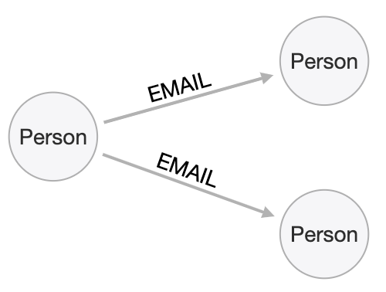
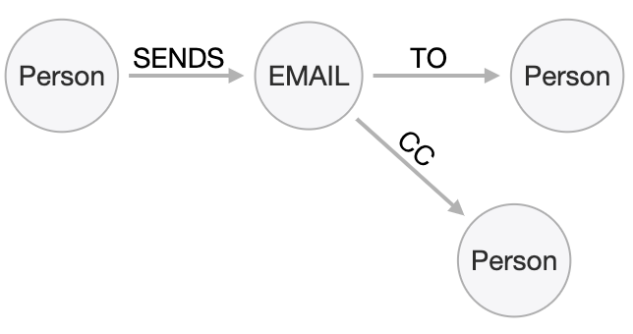
Naming relationships
Stakeholders must agree upon name
Avoid names that could be construed as nouns (for example email)
Neo4j has a limit of 16M (64k) relationship types
Notes:
Choosing good names is vital.
It needs to be something that is intuitive to stakeholders and developers alike, cannot be confused as an entity name, and is specific enough to make traversal efficient but general enough to make the Cypher easy to write. We’ll talk a lot more about this in the Design Best Practices module.
Enterprise Edition allows 16M ‘distinct’ relationship types. Community is limited to 64k.

Slide 39
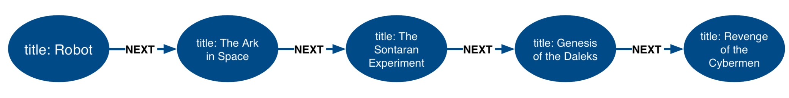
Direction and Type
Direction is required in Neo4j, and Direction and Type are related
Choose direction (and name) based on the expected questions
What episode follows The Ark in Space? (NEXT)
What episode came before Genesis of the Daleks? (PREVIOUS)
Notes:
In addition to the specificity of the relationships you also need to take into consideration the direction these relationships will have.
Any relationship could be modeled in either direction, with no effect on performance. Naturally, the type would have to differ. Here, we’ve chosen left-to-right relationships of the type NEXT. We could equally well have chosen right-to-left relationships of the type PREVIOUS. This has no effect on query performance, but the Cypher used for each variant will differ. Choose whichever variant makes the Cypher more intuitive for users to write, based on your expectations for what people will ask.
These are episodes of the Dr. Who BBC series, season 12, aired in 1975.
Any questions about the interplay between direction and type????

Slide 40
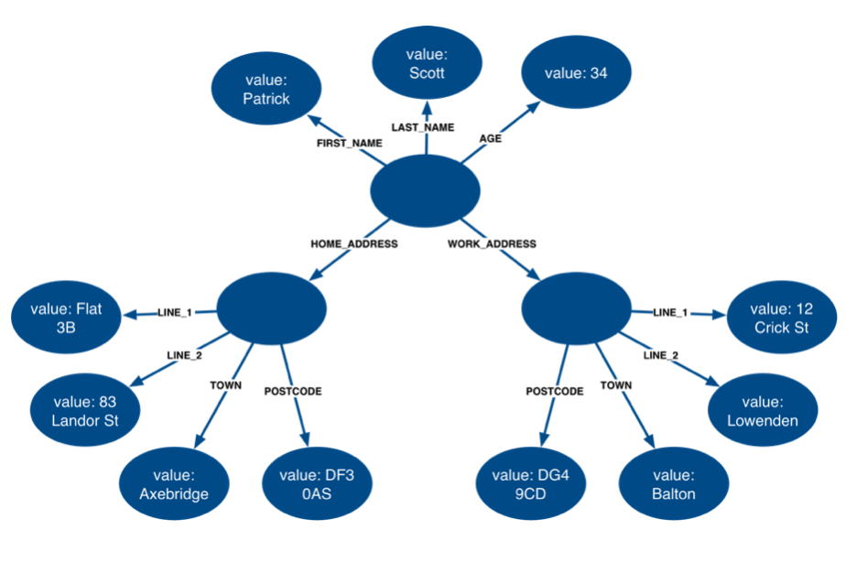
How much fanout will a node have?
HAS_LASTNAME
HAS_FIRST_NAME
IS_AGE
LIVES_AT
WORKS_AT
HAS_ADDR_1
HAS_ADDR_1
HAS_ADDR_2
HAS_ADDR_2
IN_CITY
WITH_POSTAL_CODE
IN_CITY
WITH_POSTAL_CODE
Notes:
Here, we have entities (Person, Address) represented not as a single node, but as a network or linked nodes. This is an extreme example of fanout, and is almost certainly overkill for any real-life solution, but some amount of fanout can be very useful. For example, splitting last names onto separate nodes helps answer the question, “Who has the last name Scott?”
Similarly, having Cities as separate nodes assists with the question, “Who lives in the same city as Patrick Scott?” The main risk about fanout is that it can lead to very dense nodes, or supernodes. Supernodes need to be handled carefully.
When to do fanout :
-- commonly repeated property value, city can be separate node – data de-duplication
-- making questions easy to answer
-- performance improvements in refactoring *******
Note: This model is often troubling to folks deeply immersed in RDBMS thinking. Remind them what was discussed in the Index-Free Adjacency module of the Intro course: in a graph database, it is generally better to have lots of small objects than a few large objects. Fanout like this is emblematic of that.

Slide 41
Exercise 3:
Adding relationships
to the model

Slide 42
Exercise 3: Questions and entities
What parts are needed to make Wood table 40"?
Do we have enough parts to make 100 Deluxe wood table 60"?
What products require a table brace?
How much will the parts cost to make product Wood table 60"?
Notes:
Prompt the students to identify the connections between the BOM entities together as a group Focus on type and directions first. Then check for any qualifiers that will help answer questions. Should these qualifiers be types or properties? Why? ********* The final product should be similar to below. Again, their model need not exactly match this one. Remember, the first model is never perfect. Highlight the strengths and weaknesses of their design choices later, when we start to evaluate the model against our questions.
Product -CONTAINS-> Part
quantity
Product -CONTAINS-> Assembly
quantity
Assembly -CONTAINS-> Part
quantity

Slide 43
Exercise 3: Connections
Product -CONTAINS-> Part
quantity
Product -CONTAINS-> Assembly
quantity
Assembly -CONTAINS-> Part
quantity

Slide 44
Exercise 4:
Create BOM relationshops
in Arrows
Notes:
Invite everyone to add connections to their BOM entities on their own in Arrows. Do this yourself also. Again, for Properties, encourage folks to use “expected data type” as property values; e.g., integer, String, decimal, etc.
www.apcjones.com/arrows If you don’t want to do all the clicking and typing, copy this markup: <ul class="graph-diagram-markup" data-internal-scale="0.84" data-external-scale="1">
<li class="node" data-node-id="0" data-x="-82.67394955817409" data-y="-40.13742460863777">
<span class="caption">Part</span><dl class="properties"><dt>name</dt><dd>String</dd><dt>partNumber</dt><dd>integer</dd><dt>price</dt><dd>decimal</dd></dl></li>
<li class="node" data-node-id="1" data-x="-496.7715290294119" data-y="-40.13742460863777">
<span class="caption">Product</span><dl class="properties"><dt>name</dt><dd>String</dd><dt>productID</dt><dd>integer</dd><dt>price</dt><dd>decimal</dd></dl></li>
<li class="node" data-node-id="2" data-x="-280.35411787270317" data-y="144.84305996461032">
<span class="caption">Assembly, Part</span><dl class="properties"><dt>name</dt><dd>String</dd><dt>partNumber</dt><dd>integer</dd><dt>price</dt><dd>decimal</dd></dl></li>
<li class="relationship" data-from="1" data-to="0">
<span class="type">CONTAINS</span><dl class="properties"><dt>quantity</dt><dd>integer</dd></dl></li>
<li class="relationship" data-from="1" data-to="2">
<span class="type">CONTAINS</span><dl class="properties"><dt>quantity</dt><dd>integer</dd></dl></li>
<li class="relationship" data-from="2" data-to="0">
<span class="type">CONTAINS</span><dl class="properties"><dt>quantity</dt><dd>integer</dd></dl></li>
</ul>

Slide 45
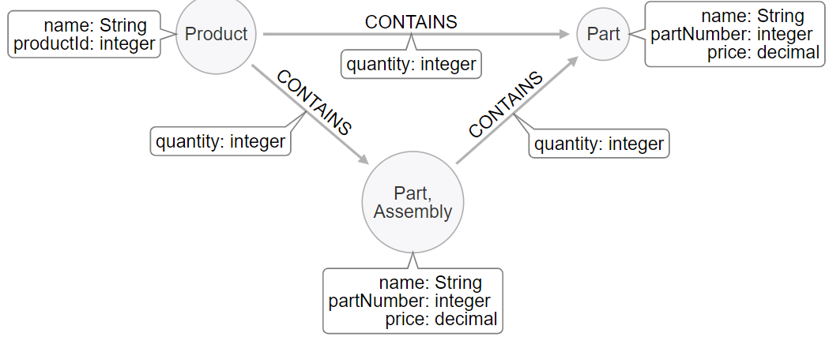
Exercise 4: Model
Notes:
Arrows markup: <ul class="graph-diagram-markup" data-internal-scale="0.75" data-external-scale="1">
<li class="node" data-node-id="0" data-x="50.682499885559075" data-y="0">
<span class="caption">Part</span><dl class="properties"><dt>name</dt><dd>String</dd><dt>partNumber</dt><dd>integer</dd><dt>price</dt><dd>decimal</dd></dl></li>
<li class="node" data-node-id="1" data-x="-144.0450007120768" data-y="172.05374717712397">
<span class="caption">Part, Assembly</span><dl class="properties"><dt>name</dt><dd>String</dd><dt>partNumber</dt><dd>integer</dd><dt>price</dt><dd>decimal</dd></dl></li>
<li class="node" data-node-id="2" data-x="-345.4412714640299" data-y="0">
<span class="caption">Product</span><dl class="properties"><dt>name</dt><dd>String</dd><dt>productId</dt><dd>integer</dd></dl></li>
<li class="relationship" data-from="2" data-to="0">
<span class="type">CONTAINS</span><dl class="properties"><dt>quantity</dt><dd>integer</dd></dl></li>
<li class="relationship" data-from="2" data-to="1">
<span class="type">CONTAINS</span><dl class="properties"><dt>quantity</dt><dd>integer</dd></dl></li>
<li class="relationship" data-from="1" data-to="0">
<span class="type">CONTAINS</span><dl class="properties"><dt>quantity</dt><dd>integer</dd></dl></li>
</ul>

Slide 46
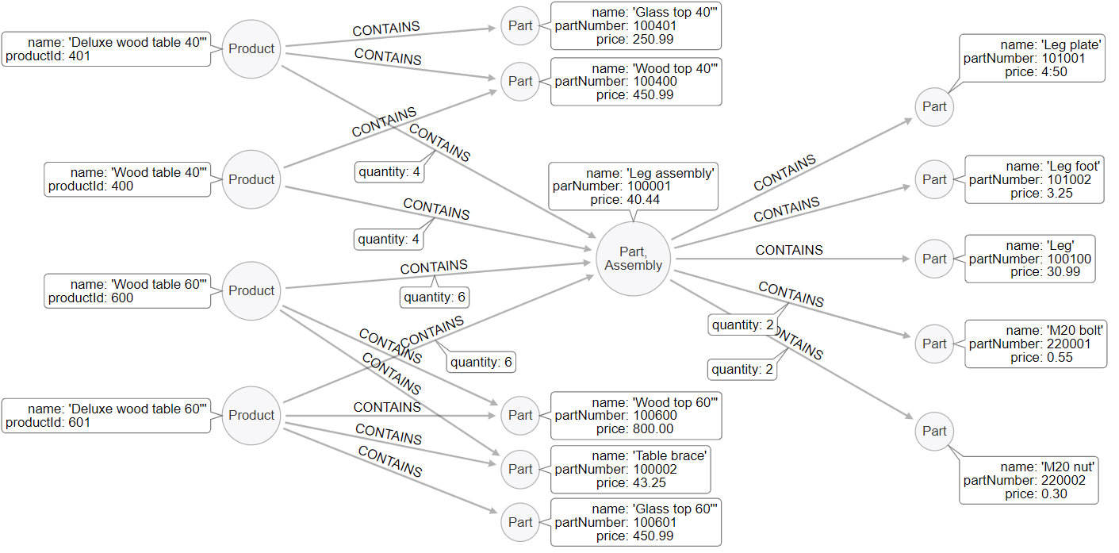
Exercise 4: Sample data
Person
Notes:
Whenever a CONTAINS relationship has no quantity property, we assume quantity = 1 This sample data begins to show why Assembly is a useful structure . If we did not have Assembly as an entity, every Part that goes into table legs would need to have duplicated relationships to every Product that uses table legs. That would add significant density to both Product and Part nodes. As for why we want the dual labels. Labeling assemblies as Parts makes some of the Cypher queries easier to write. On the other hand, the label Assembly helps human users understand the significance of these “intermediate parts” at a glance. ********** Arrows markup: <ul class="graph-diagram-markup" data-internal-scale="0.75" data-external-scale="1">
<li class="node" data-node-id="0" data-x="-345.4412714640299" data-y="355.6422119140624">
<span class="caption">Product</span><dl class="properties"><dt>name</dt><dd>'Wood table 60"'</dd><dt>productId</dt><dd>600</dd></dl></li>
<li class="node" data-node-id="1" data-x="-345.4412714640299" data-y="17.62464618682847">
<span class="caption">Product</span><dl class="properties"><dt>name</dt><dd>'Deluxe wood table 40"'</dd><dt>productId</dt><dd>401</dd></dl></li>
<li class="node" data-node-id="2" data-x="-345.4412714640299" data-y="199.74443022410088">
<span class="caption">Product</span><dl class="properties"><dt>name</dt><dd>'Wood table 40"'</dd><dt>productId</dt><dd>400</dd></dl></li>
<li class="node" data-node-id="3" data-x="-345.4412714640299" data-y="529.8155937194823">
<span class="caption">Product</span><dl class="properties"><dt>name</dt><dd>'Deluxe wood table 60"'</dd><dt>productId</dt><dd>601</dd></dl></li>
<li class="node" data-node-id="4" data-x="30.527327269315723" data-y="63.11414146423326">
<span class="caption">Part</span><dl class="properties"><dt>name</dt><dd>'Wood top 40"'</dd><dt>partNumber</dt><dd>100400</dd><dt>price</dt><dd>450.99</dd></dl></li>
<li class="node" data-node-id="5" data-x="609.4605747858683" data-y="551.8277514775586">
<span class="caption">Part</span><dl class="properties"><dt>name</dt><dd>'M20 nut'</dd><dt>partNumber</dt><dd>220002</dd><dt>price</dt><dd>0.30</dd></dl></li>
<li class="node" data-node-id="6" data-x="30.527327269315723" data-y="605.0613317489621">
<span class="caption">Part</span><dl class="properties"><dt>name</dt><dd>'Table brace'</dd><dt>partNumber</dt><dd>100002</dd><dt>price</dt><dd>43.25</dd></dl></li>
<li class="node" data-node-id="7" data-x="188.62522285183277" data-y="310.58522319793684">
<span class="caption">Part, Assembly</span><dl class="properties"><dt>name</dt><dd>'Leg assembly'</dd><dt>parNumber</dt><dd>100001</dd><dt>price</dt><dd>40.44</dd></dl></li>
<li class="node" data-node-id="8" data-x="609.4605747858683" data-y="429.5683333079018">
<span class="caption">Part</span><dl class="properties"><dt>name</dt><dd>'M20 bolt'</dd><dt>partNumber</dt><dd>220001</dd><dt>price</dt><dd>0.55</dd></dl></li>
<li class="node" data-node-id="9" data-x="609.4605747858683" data-y="199.74443022410088">
<span class="caption">Part</span><dl class="properties"><dt>name</dt><dd>'Leg foot'</dd><dt>partNumber</dt><dd>101002</dd><dt>price</dt><dd>3.25</dd></dl></li>
<li class="node" data-node-id="10" data-x="609.4605747858683" data-y="98.58790914217629">
<span class="caption">Part</span><dl class="properties"><dt>name</dt><dd>'Leg plate'</dd><dt>partNumber</dt><dd>101001</dd><dt>price</dt><dd>4:50</dd></dl></li>
<li class="node" data-node-id="11" data-x="609.4605747858683" data-y="310.58522319793684">
<span class="caption">Part</span><dl class="properties"><dt>name</dt><dd>'Leg'</dd><dt>partNumber</dt><dd>100100</dd><dt>price</dt><dd>30.99</dd></dl></li>
<li class="node" data-node-id="12" data-x="30.527327269315723" data-y="678.7611147562659">
<span class="caption">Part</span><dl class="properties"><dt>name</dt><dd>'Glass top 60"'</dd><dt>partNumber</dt><dd>100601</dd><dt>price</dt><dd>450.99</dd></dl></li>
<li class="node" data-node-id="13" data-x="30.527327269315723" data-y="-14.911466916402228">
<span class="caption">Part</span><dl class="properties"><dt>name</dt><dd>'Glass top 40"'</dd><dt>partNumber</dt><dd>100401</dd><dt>price</dt><dd>250.99</dd></dl></li>
<li class="node" data-node-id="14" data-x="30.527327269315723" data-y="529.8155937194823">
<span class="caption">Part</span><dl class="properties"><dt>name</dt><dd>'Wood top 60"'</dd><dt>partNumber</dt><dd>100600</dd><dt>price</dt><dd>800.00</dd></dl></li>
<li class="relationship" data-from="2" data-to="4">
<span class="type">CONTAINS</span>
</li>
<li class="relationship" data-from="1" data-to="4">
<span class="type">CONTAINS</span>
</li>
<li class="relationship" data-from="1" data-to="13">
<span class="type">CONTAINS</span>
</li>
<li class="relationship" data-from="1" data-to="7">
<span class="type">CONTAINS</span><dl class="properties"><dt>quantity</dt><dd>4</dd></dl></li>
<li class="relationship" data-from="2" data-to="7">
<span class="type">CONTAINS</span><dl class="properties"><dt>quantity</dt><dd>4</dd></dl></li>
<li class="relationship" data-from="0" data-to="7">
<span class="type">CONTAINS</span><dl class="properties"><dt>quantity</dt><dd>6</dd></dl></li>
<li class="relationship" data-from="0" data-to="14">
<span class="type">CONTAINS</span>
</li>
<li class="relationship" data-from="3" data-to="12">
<span class="type">CONTAINS</span>
</li>
<li class="relationship" data-from="3" data-to="14">
<span class="type">CONTAINS</span>
</li>
<li class="relationship" data-from="3" data-to="6">
<span class="type">CONTAINS</span>
</li>
<li class="relationship" data-from="0" data-to="6">
<span class="type">CONTAINS</span>
</li>
<li class="relationship" data-from="3" data-to="7">
<span class="type">CONTAINS</span><dl class="properties"><dt>quantity</dt><dd>6</dd></dl></li>
<li class="relationship" data-from="7" data-to="11">
<span class="type">CONTAINS</span>
</li>
<li class="relationship" data-from="7" data-to="10">
<span class="type">CONTAINS</span>
</li>
<li class="relationship" data-from="7" data-to="9">
<span class="type">CONTAINS</span>
</li>
<li class="relationship" data-from="7" data-to="8">
<span class="type">CONTAINS</span><dl class="properties"><dt>quantity</dt><dd>2</dd></dl></li>
<li class="relationship" data-from="7" data-to="5">
<span class="type">CONTAINS</span><dl class="properties"><dt>quantity</dt><dd>2</dd></dl></li>
</ul>

Slide 47
Building the initial data model
Understand the domain
Create sample data
Define specific questions for the application
Identify entities
Identify connections between entities
Test the questions against the model
Test scalability
Notes:
We go by our questions bit by bit and see how neo4j will anchor and traverse.

Slide 48
Testing the model
What parts are needed
to make Wood table 40"?
Part
Part
Product
Part
Part
Part
Part
Part
Notes:
To answer the first question, we would anchor on the Wood table 40" node, and iteratively traverse all CONTAINS until we get all of the parts required to make the product. Multiply by the quantity property as you go.

Slide 49
Testing the model
Do we have enough parts to make 100x Deluxe wood table 60"?
Part
Part
Part
Part
Part
Product
Part
X 100
Notes:
The application code that supports this question would need to come up with the inventory of parts needed to assemble the Deluxe wood table 60" and then multiply the parts list by 100. The application would then be integrated with an inventory application to truly answer the question.
Frequently, during the entity identification stage, the question of inventory comes up. Different people will advocate for or against it. Both cases work, but with different strengths and weaknesses. If inventory is in the graph, the application architecture can be simpler--no need to integrate two data sources at query time. The downside is that stock numbers change frequently, and whenever they do, you will need to update the graph data. Neo4j is not specifically bad for frequent updates, but it offers no benefits in that area relative to other data management solutions. Ideologically, we at Neo4j see graph databases as a problem-solving complement to the existing data management paradigm. If you were maintaining stock data somewhere else anyway, there is no inherent need to move it into Neo4j.

Slide 50
Testing the model
What products require a table brace?
Product
Part
Notes:
For this question, the application would anchor on the Part with the name table brace. Then it would traverse backwards along each CONTAINS to find the products that use it.

Slide 51
Testing the model
How much will the parts cost
to make Wood table 60"?
Part
Part
Part
Part
Product
Part
Part
Notes:
We anchor on the Wood table 60" product, and iteratively traverse each CONTAINS to the parts that the product contains. The application would simply add up the prices of the parts (multiplied by quantity when applicable) to come up with the total price.
During the entity identification stage, there is often a debate about whether Assembly nodes should contain a price, or if price should be kept only on the Part leaf nodes. That debate may even extend to whether price should be kept on Product nodes. Again, there is no “right” answer, only tradeoffs to be aware of. If price is only on Parts, then this query needs to traverse further in order to find the answer. The benefit is that data updates are easier. If Assembly has a price, then that price is affected by any price changes of the sub-parts; ditto if price is on Products. The added complexity in data maintenance is generally undesirable. However, one big benefit of putting price at the Assembly level is that the Cypher for this question is simpler and more predictable. You can guarantee that Price is available exactly one hop away from the anchor node in all cases. This modeler felt that that benefit balanced out the added data maintenance expense.

Slide 52
Building the initial data model
Understand the domain
Create sample data
Define specific questions for the application
Identify entities
Identify connections between entities
Test the questions against the model
Test scalability

Slide 53
Testing scalability
How many products?
How many parts?
How often are products added?
How often do prices change?
Are prices based upon time?
Is inventory part of the model?
Part
Part
Product
Part
Part
Part
Part
Part
Notes:
Scalability questions should be asked by stakeholders and developers. Developers will have a better idea of the challenges with implementing the model as it scales so they are a key player in doing the scalability analysis. Stakeholders would have a better idea of how many products and parts, how often prices change etc. Here, we are only looking for conceptual scalability concerns. We will also do this at the level of individual query performance during the Implementation portion of the course.

Slide 54
Break and Exercise
:play neo4j-modeling-exercises
Exercise
Notes:
Before coming to the class, the students should have downloaded and uncompressed:
https://r.neo4j.com/neo4j-intro-modeling
This file contains exercise files and also solutions to the exercises.

Slide 55
Exercise: Instructions
Important: Download and uncompress the course files: https://r.neo4j.com/neo4j-intro-modeling
Domain: Knowledge management of the skills of people that work for the same company
Question: What people in the company have the same skills as me?
Steps:
Identify the entities and relationships based upon the above question.
Go to Arrows: http://www.apcjones.com/arrows.
Open the KM-sample-data.txt and view the sample data you will work with to develop the model using Arrows.
Create the graph data model using the sample data and the entities and relationships you have identified.
Save the model as KM.htm and KM.svg.

Slide 56
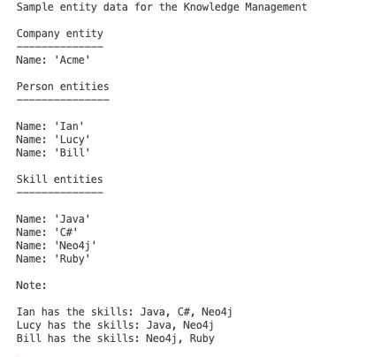
Exercise: Instructions
Domain: Knowledge management of the skills of people that work for the same company
Question: What people in the company have the same skills as me?

Slide 57
Exercise: Solution
Entities:
I want to know what people who work for the company have the same skills as me.
Answer: Person, Company, Skill
Relationships:
I want to know what people who work for the company have the same skills as me.
Answer: WORKS_FOR, HAS_SKILL

Slide 58
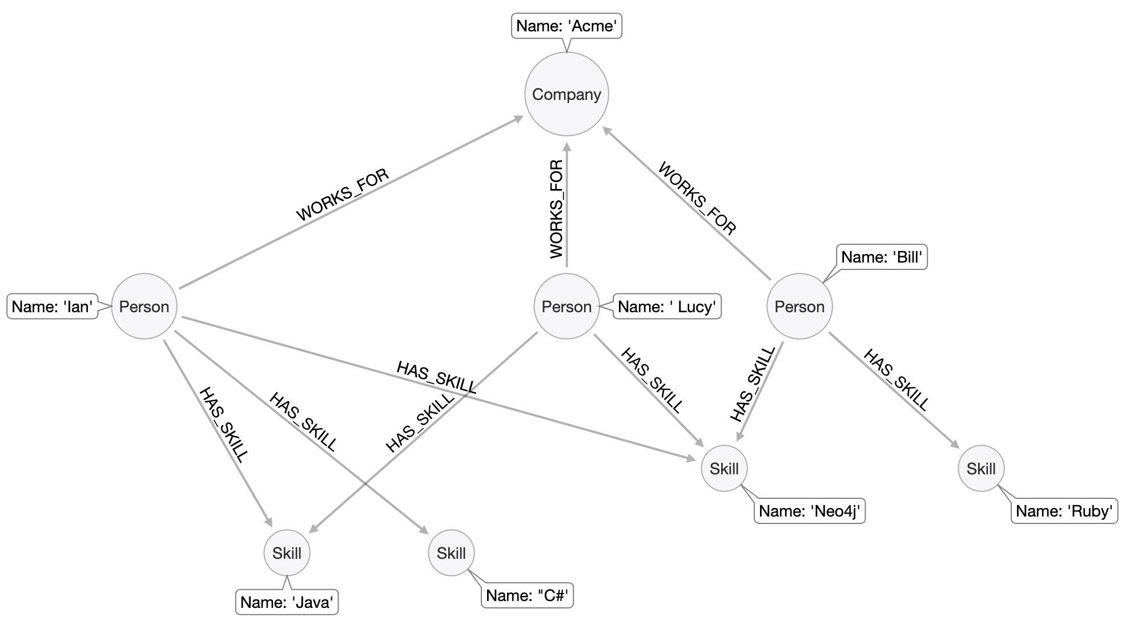
Exercise: Solution

Slide 59
Thank you!

Slide 60
Graph Modeling Core Principles

Slide 61
Graph Modeling Core Principles
Entities
Uniqueness
Fanout
Relationships
Naming best practices
Semantic redundancy
Types vs. Properties
Properties
Data object accessibility
Notes:
In this section, we will look at some best practices and rules of thumb when designing different aspects of your data model. We will look specifically at these topics.

Slide 62
Entity best practices

Slide 63
Ensure uniqueness of nodes
Person
Person
Person
Person
Person
Person
Name: 'Ann Smith'
Name: 'Jim Jones'
Name: 'Ann Smith'
Name: 'Ann Smith'
Name: 'Jim Jones'
Name: 'Ann Smith'
Address
Address
Address
Address
Address
Address
Line1: '500 Main St.'
Line1: '500 Main St.'
Line1: '500 Main St.'
Line1: '500 Main St.'
Cord: [51.508530,
-0.076132]
Line1: '500 Main St.'
Cord: [51.103946,
-0.183639]
Line1: '500 Main St.'
Cord: [46.693829,
-0.348274]
PostalCode
PostalCode
PostalCode
PostalCode
PostalCode
PostalCode
Code: 'SW1A 0AA'
Code: 'EC1A 1BB'
Code: 'EC1A 1BB'
Code: 'SW1A 0AA'
Country: 'UK'
Code: 'EC1A 1BB'
Country: 'UK'
Code: 'EC1A 1BB'
Country: 'GMB'
Code: 'UK'
Code: 'GMB'
Code: 'UK'
Code: 'GMB'
Country
Country
Country
Country
Notes:
In models like this one, an address should be uniquely identified because it should represent a single point of data in the graph. This is important in fraud detection applications where variations of the same address may be used to make a fraudulent transaction against the application. In this particular example, it is clear from the wider context that the various 500 Main St nodes are all distinct places. But this nonetheless makes it harder to anchor on Address Line 1, and more difficult to modify the graph data later. We consider it a best practice to always have a property (or set of properties) that uniquely identify a node. Here, we’ve added a geolocation property to do so. That property will likely never be used as a query tool.

Slide 64
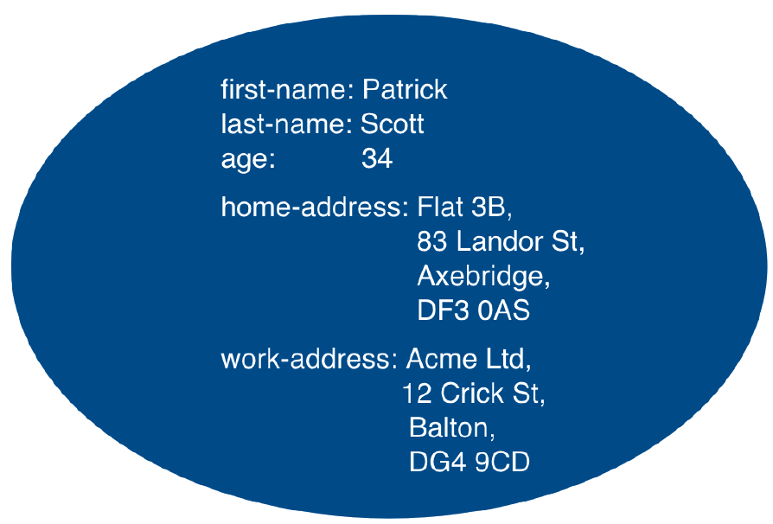
Use fanout judiciously
LastName
FirstName
Age
Person
HAS_LASTNAME
HAS_FIRST_NAME
IS_AGE
Person
LIVES_AT
WORKS_AT
Street1
Address
Address
Street1
HAS_ADDR_1
HAS_ADDR_1
HAS_ADDR_2
HAS_ADDR_2
Street2
IN_CITY
Street2
WITH_POSTAL_CODE
WITH_POSTAL_CODE
IN_CITY
PostalCode
City
City
Reduce property duplication
Reduce gather-and-inspect
PostalCode
Notes:
We have here two extreme examples. On the left we have no fanout, and on the right, maximum fanout (maximum one property per node). Both cases are usually suboptimal. In general, you use fanout to do one of two things.
Reduce duplication of properties. Instead of having a repeated property on every node, you can instead have all of those nodes connected to a shared node with that property. This can make data updates massively easier.
Reduce gather-and-inspect behavior during a traversal. In the left-side case, for example, if we want to find every address in the city of Axebridge, we would need to check the properties on EVERY Person node, then discard most of them. This is grossly inefficient. In the right-side case, this is a simple matter of locating the singular Axebridge node, and traversing to every Address node connected to it. This model has no “wasted” hops.
As a result, you generally use fanout for anchors and navigators. You almost never see fanout used for output, unique identifier, or decorator properties, because it makes traversal a few hops longer for no real benefit. This is why the maximum-fanout case on the right is usually undesirable: it is almost never the case that EVERY property is an anchor or navigator!

Slide 65
Relationship best practices

Slide 66
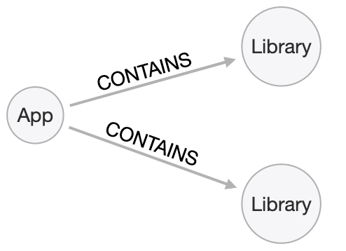
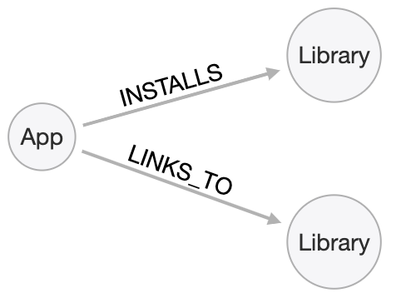
Best practice: Use specific types...
Notes:
Being specific with property types allows you to reduce gather-and-inspect behavior. In this case, if you’re only interested in what libraries will be INSTALLED by an app, the specific types on the right saves you some wasted traversal.

Slide 67
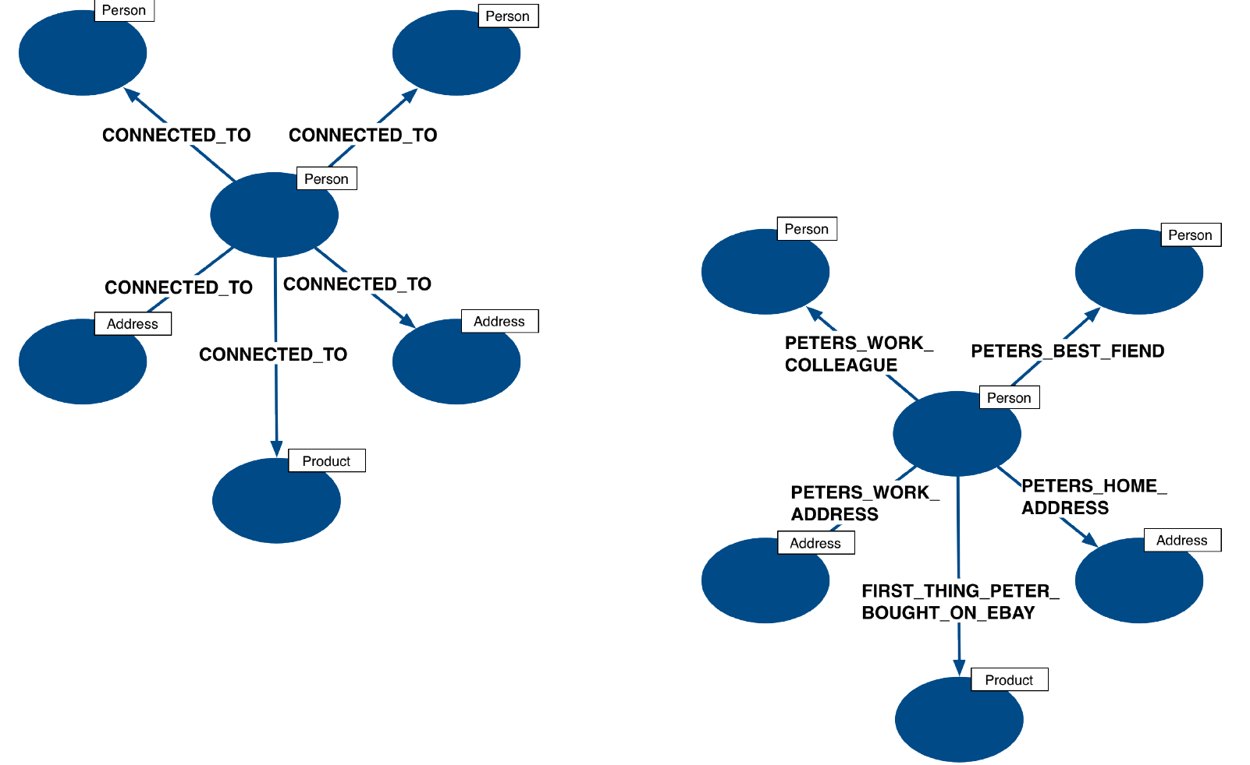
...but not too specific
Too specific
PETER_WORKS_WITH
PETER_IS_FRIENDS_WITH
PETER_WORKS_AT
PETER_LIVES_AT
Not specific enough
PETER_FIRST_BOUGHT_ON_EBAY
Notes:
But it is possible to be TOO specific! The model on the right makes it impossible to write generalized queries. If you want to find every person who works at a given address, you would need to write a massive OR clause to include every person’s name in the relationship type..

Slide 68
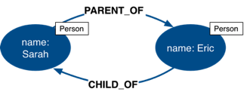
Best practice: No symmetric relationships
You should probably not do this.
OR
Choose one or the other.
Notes:
Semantically symmetrical relationships present two problems. “ First, they are a form of needless data duplication. PARENT_OF and CHILD_OF mean exactly the same thing; you cannot have one be true and the other not. Second, they allow you to violate the Cypher expectation of relationship uniqueness. Semantically, you have two identical relationships--they just look different technically. This allows you to traverse the “same” relationship twice.

Slide 69
Best practice: No symmetric relationships
Not all mutual relationships are semantically symmetric
FOLLOWS
FOLLOWS
Sarah following Eric does not automatically mean that Eric follows Sarah, and the distinction is meaningful

Slide 70
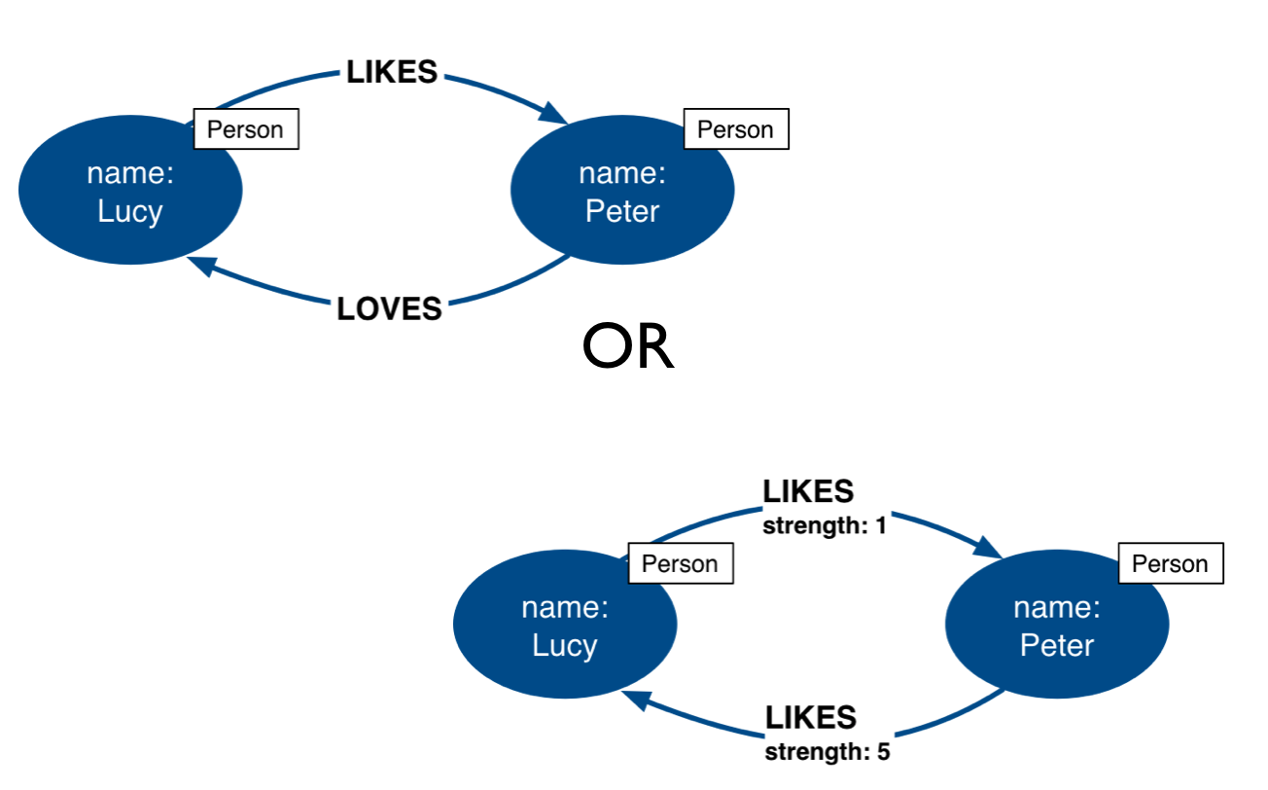
Types vs Properties
.
Notes:
Both of these models represent the same idea in different ways. Neither is strictly superior; both are optimized for a certain kind of question. For example, if you want to find all LOVES relationships, but ignore the weaker LIKES ones, the top model is best. Traversal will not involve any gather-and-inspect.
On the other hand, if you want to rank the strength of all relationships, the below model is better. The Cypher string required is much simpler, and we know there will not be any gather-and-inspect discards because we want everything anyway.

Slide 71
Property best practices

Slide 72
Best practice: Use simple properties
Property lookups have a cost. Parsing a complex property adds more cost
Person
Anchors and navigators should be as simple as possible
Identifiers, outputs, and decoration are OK as complex values
Notes:
When talking about properties, every Best Practice has exceptions.
In the case of property value complexity, it depends on how the property is used. Anchors and navigators need to be parsed at query time. If the cost of parsing them is high, querying slows down. Other properties, though, just need to be returned as-is. Because they do not require parsing, complexity there doesn’t matter much. In other words, this “bad model” from before might actually be OK. If those addresses are never used as an anchor or a navigator, and only as an output, then their complexity will not slow querying down.

Slide 73
Data object accessibility

Slide 74
Hierarchy of accessibility
For each data object, how much work must Neo4j do to evaluate if this is a “good” path or a “bad” one?
Most accessible Least processing required
Anchor node label Anchor node properties (indexed)
Relationship types
Anchor node properties (non-indexed)
Downstream node labels
Relationship properties Downstream node properties
Anchor Node
Downstream Nodes
Least accessible Most processing required
Notes:
Neo4j allows you to put data in Labels, Properties, and Relationship Types. In most cases, there is a way you can model things so that a given data item is in any one of these three locations. When designing or refactoring a model, you can estimate performance by checking how “accessible” your navigation data are. For example, Anchor node data is cheapest to access--it involves no traversal at all, and thus no wasted traversal. But indexed anchor properties are much more accessible than non-indexed anchor properties. Neo4j is purpose-designed for easy traversal, so Relationship Types are also very cheap to access. In fact, we recommend using types in Cypher queries always, because the cost of the type lookup is minimal. And if you don’t use Type as a navigator, you will likely use something even less accessible, like downstream properties. Downstream information— i.e.-- labels and properties alike-- are the most expensive thing to access, and the further downstream, the more expensive the are. That isn’t to say they are necessarily deal-breakers, but elevating downstream data via a model change is one of the most reliable ways to improve query performance. For example, reduce how far downstream a query must go to get the necessary data, or change the model so that the downstream data is available in a Type instead of a label or property. *********** Keep in mind, however, that query performance is not the ONLY metric that matters! Query simplicity, write/update speed, and the human-intuitiveness of a model are also important factors. When considering whether to elevate some data along this hierarchy, speed must be weighed against the impact this will have on those other factors.

Slide 75
Thank you!

Slide 76
Common Graph Structures

Slide 77
Common graph structures
Intermediate node
Linked list
Timeline tree
Multiple structures in a single model
Notes:
In this module, we will discuss some common graph structures. Some of these are more common and some less. The goal is that you will be able to recognize the circumstances where these structures are useful, and will not need to reinvent the wheel.

Slide 78
Intermediate nodes

Slide 79
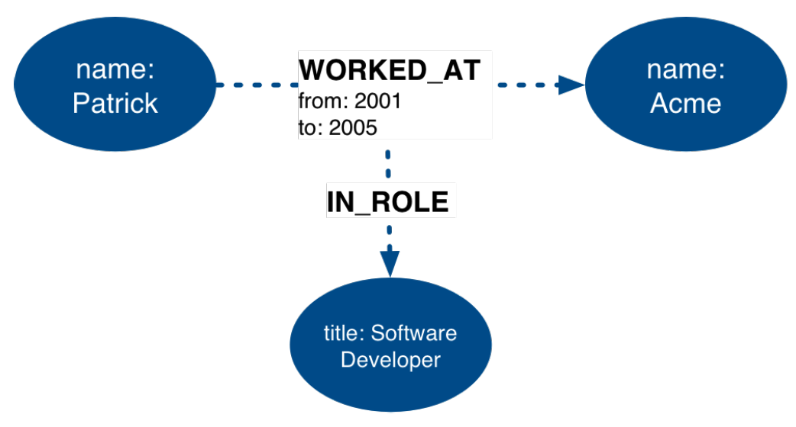
Intermediate nodes
Connect more than two nodes in a single context.
Hyperedges (n-ary relationships)
When you need to relate something to a relationship.
Person
Company
Position
Notes:
You sometimes find cases where it feels like you need to connect more data to a relationship than can be fully captured in the properties. In other words, you want a relationship that connects more than two nodes. Mathematics allows this, with the concept of a hyperedge. This is impossible in Neo4j

Slide 80
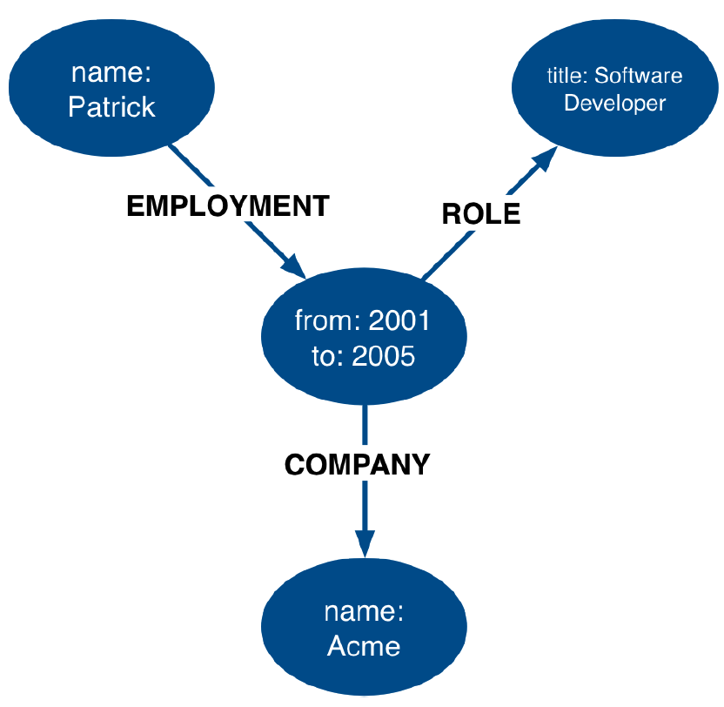
Intermediate nodes
Person
Position
WORKED_FROM
IN_ROLE
Employment
AT_COMPANY
Company
Notes:
The solution is to add a connection point in the middle of the relationship. Since nodes are connection points, you simply create a node in the middle of the relationship. In this example, we replaced the WORKED_AT relationship with an Employment intermediate node. This provides a connection point that allows us to connect any amount of information to Patrick’s term of employment at Acme.

Slide 81
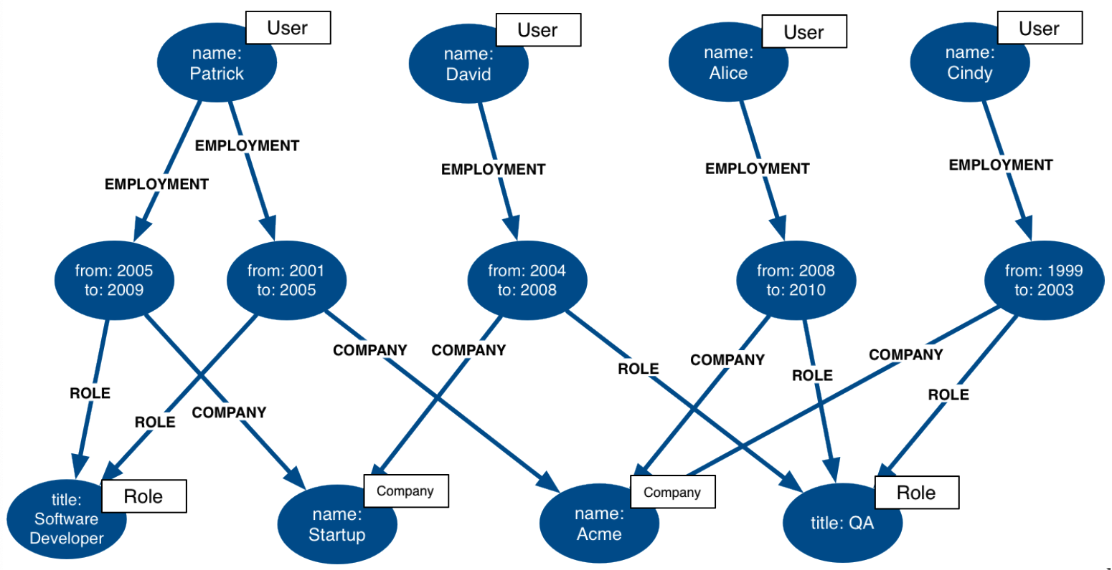
Intermediate nodes: sharing context
Person
Person
Person
Person
WORKED_FROM
WORKED_FROM
WORKED_FROM
WORKED_FROM
WORKED_FROM
Employment
Employment
Employment
Employment
Employment
AT_COMPANY
AT_COMPANY
AT_COMPANY
AT_COMPANY
IN_ROLE
IN_ROLE
IN_ROLE
AT_COMPANY
IN_ROLE
IN_ROLE
Notes:
What’s more, this arrangement allows different employment events to share contextual information. They can have a shared Role or Company, and allow us to very easily trace either the full details of a single person’s career, or the overlap between different individuals

Slide 82
Intermediate nodes: sharing data
Person
name: Lucy
Person
name: Lucy
EMAILED_TO
content: ...
TO
Person
Person
Person
Email
name: Sarah
name: Claire
name: Sarah
content:...
EMAILED_CC
content: ...
SENT
EMAILED_CC
content: ...
Person
CC
CC
name: David
Person
Person
name: David
name: Claire
Notes:
Intermediate nodes also allow you to deduplicate information. We mentioned a similar principle when we discussed Fanout; that splitting a property onto its own node allows you to reference it via a relationship instead of a repeated property. In this case, the Email intermediated node spares us having to repeat the email content on every single relationship.

Slide 83
Intermediate nodes: organizing data
Person
Person
name: Sarah
name: Sarah
Notes:
In addition, intermediate nodes can be invaluable organizing structures. This is a more expansive zoomed-out view of the same data as the last slide. The light blue nodes are the Email intermediate nodes. When we model Email as a relationship, as on the left, we encounter two problems. First, Sarah’s node becomes extremely dense. For every single recipient of any message she writes, she gains another relationship. On the right, she only has one relationship per email, regardless of the number of recipients. Dense nodes can be tricky to work with.
Second, it is difficult and expensive to determine who in Sarah’s recipient network has received a given message. In the left model, we need to traverse every relationship and check the email content to see which messages are shared. In this specific case, that requires between six and nine “wasted” hops, depending on whether we’re looking for the four-recipient message or the one-recipient message. On the right, with the Email intermediate node, we still need to check every message; but having done so, we can guarantee that every node connected to that email is a relevant one. There will only ever be three “wasted” hops.

Slide 84
Linked lists

Slide 85


Simple linked lists
Episodes of the Dr.Who series:
Doubly linked list. NO NEED NOT DO THIS
Notes:
Linked lists are useful whenever the sequence of objects matters. The typical pattern is to define relationships between sequential items with the names NEXT or PREVIOUS, although those words are not verbs. As always, choose one or the other based on the questions you expect to ask. Linked lists are not unique to graphs. They are a common idea in lots of data modeling paradigms. In some of those paradigms, you see both the Singly-linked list, as above, and the Doubly-linked list, as below. But you should NEVER use a doubly-linked list in Neo4j. Concept check: who can tell me why not? Answer: Doubly linked lists use redundant symmetrical relationships. We discussed before why those are a bad idea in Neo4j.

Slide 86
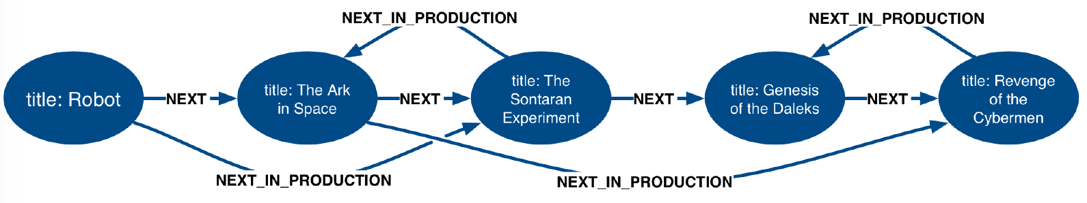
Interleaved linked list
Notes:
However, you can add complexity to linked lists. Sometimes, there are multiple ways you could sequence a set of items. For example, the order in which TV show episodes are shown is not always the same order in which they were created. Here, we again have the episodes of Dr. Who season 12, but with two sequences: the order of airing (NEXT) and the order of production (NEXT_IN_PRODUCTION)

Slide 87
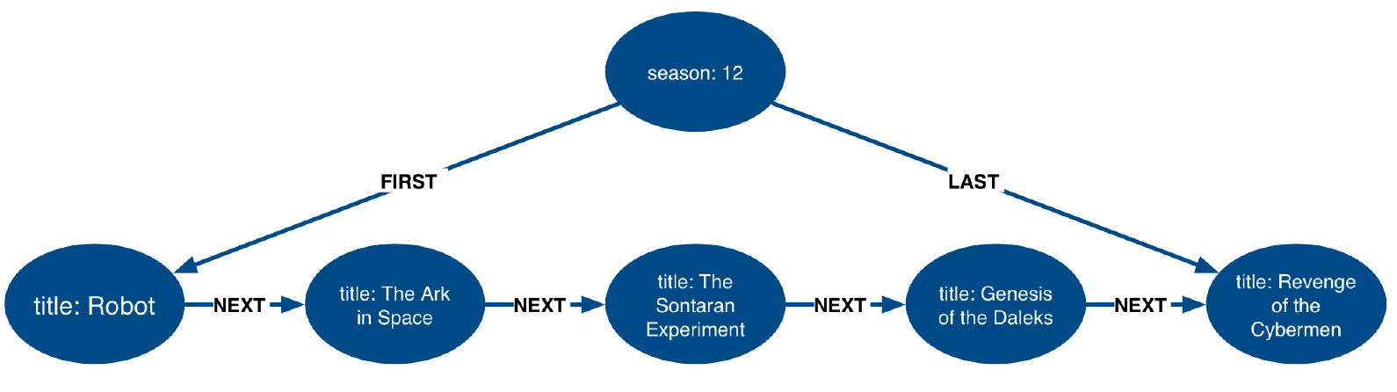
Pointers to head, tail, and current
LATEST_AIRED
Notes:
When working with linked list, there is generally a “parent” node that is used as the entry point. That parent almost always points to the first item in the sequence, using an appropriately named relationship. It may also point to the last item. For cases where you are tracking progress through the sequence, the parent node may also have a pointer to the “current” item.

Slide 88
Timeline tree
Notes:
Trees are

Slide 89
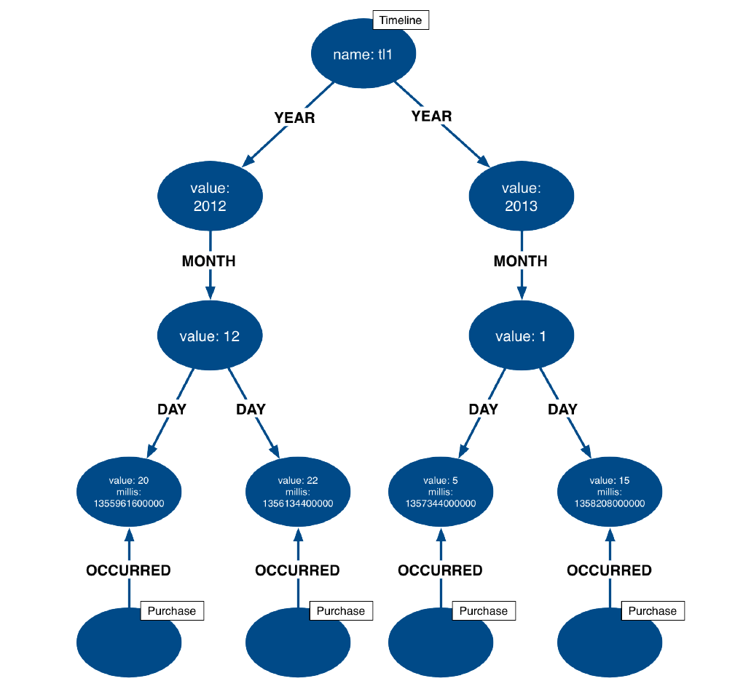
Timeline tree
Retrieve all purchases in a [month, day, year]
Retrieve all purchases happening within the same [day, month, year] as another purchase
IN_YEAR
IN_YEAR
IN_MONTH
IN_MONTH
ON_DAY
ON_DAY
ON_DAY
ON_DAY
Notes:
Trees are not complicated beasts, so we won’t spend any time talking about trees generally. But we will discuss one special kind of tree, the timeline tree. Timeline trees can be a useful structure when you want to use time as either an anchor or a navigational aid in your querying, and when the periods of time that interest you vary. The topmost node in the timeline is an “all time” node. That then subdivides into whatever time periods interest you. Here, we have chosen years, months, and days; we could just have equally chosen quarters, weeks, hours, minutes, or anything else.
All of our “data” nodes then link into the timeline tree at the appropriate leaf node. Here, we have connected every purchase to a day. With this structure, some otherwise-expensive time questions become easy. For example, finding all purchases in a given time periods, where the period of interest might be a day, a month, or a year, depending on circumstances. Simply anchor on the timeline at the appropriate time period of interest, then traverse downward through the tree. What is more interesting, though, is dealing with time when time is a navigator, but not the anchor. For example, looking for all purchases that happened within a some time period relative to another event. You anchor on the specified event, traverse into the timeline tree, navigate to the appropriate time period of interest, then traverse downward. Without a timeline structure in the graph, this kind of query frequently involves a lot of property lookups and inefficient gather-and-inspect. ******** HOWEVER, that is not to say that timeline trees are the go-to “best” method of expressing time! Quite the opposite--timeline trees consume a lot of space relative to the data the contain. Most often, even when time is an important part of the answer to a question, a simple property is sufficient. But I’m sharing this structure with you so that, in cases where a property alone is not good enough, you don’t need to reinvent the concept of a timeline tree yourself.

Slide 90
Using multiple structures

Slide 91
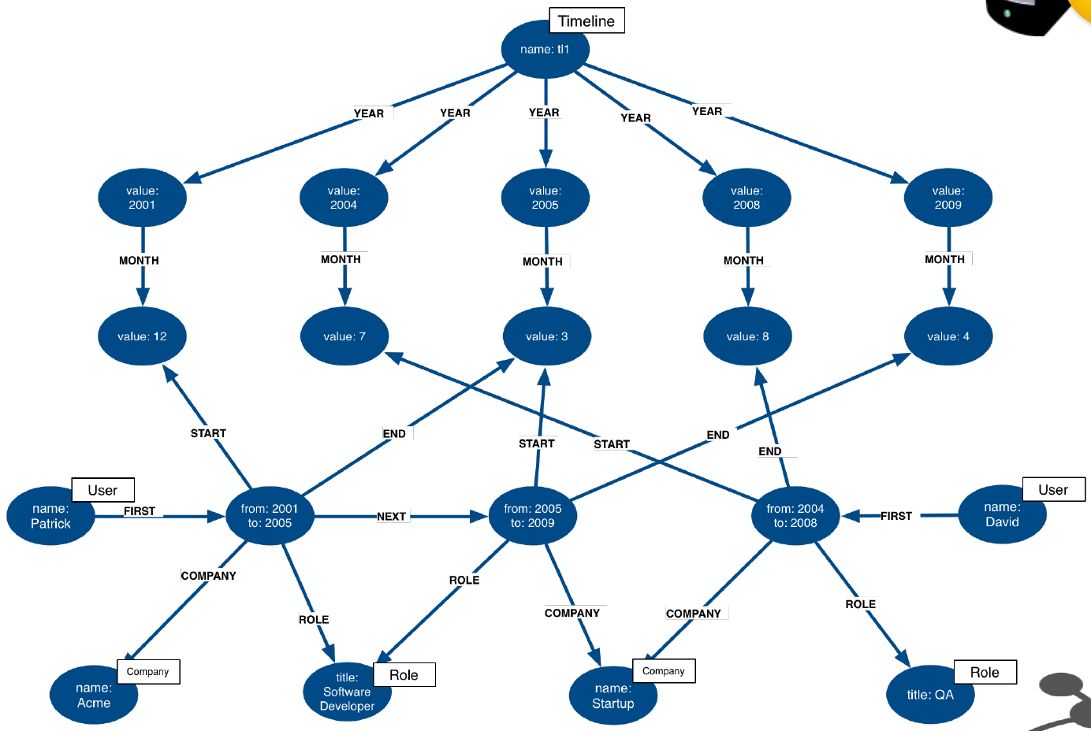
Multiple structures in a single model
IN_YEAR
IN_YEAR
IN_YEAR
IN_YEAR
IN_YEAR
IN_MONTH
IN_MONTH
IN_MONTH
IN_MONTH
IN_MONTH
STARTED
ENDED
STARTED
ENDED
STARTED
ENDED
AT_COMPANY
IN_ROLE
IN_ROLE
AT_COMPANY
AT_COMPANY
IN_ROLE
Notes:
All of the structures we’ve seen so far are not entire models in their own right. They are tiny patterns with specific use cases and strengths. Modeling questions as a whole are usually larger and more complex than that. Frequently, you will see multiples of these structures used together in order to fully solve a problem. Here is one example.

Slide 92
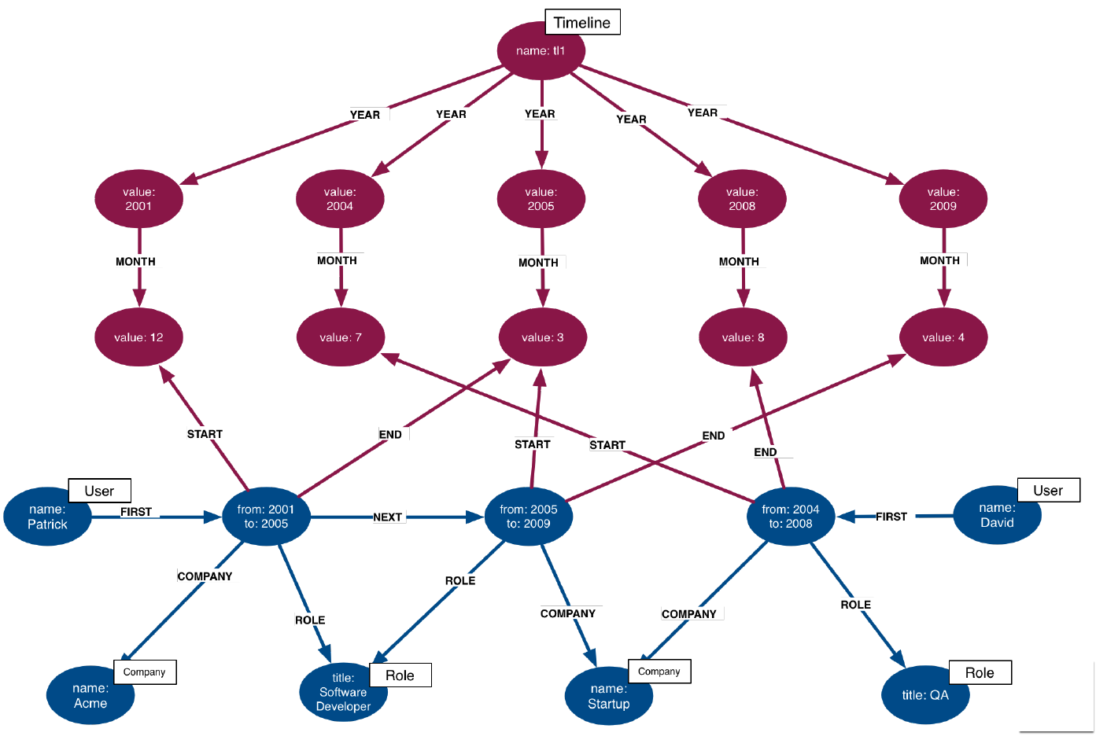
Timeline tree
IN_YEAR
IN_YEAR
IN_YEAR
IN_YEAR
IN_YEAR
IN_MONTH
IN_MONTH
IN_MONTH
IN_MONTH
IN_MONTH
STARTED
ENDED
STARTED
ENDED
STARTED
ENDED
AT_COMPANY
IN_ROLE
IN_ROLE
AT_COMPANY
AT_COMPANY
IN_ROLE
Notes:
At the top, we have a timeline tree, subdivides into years and months.

Slide 93
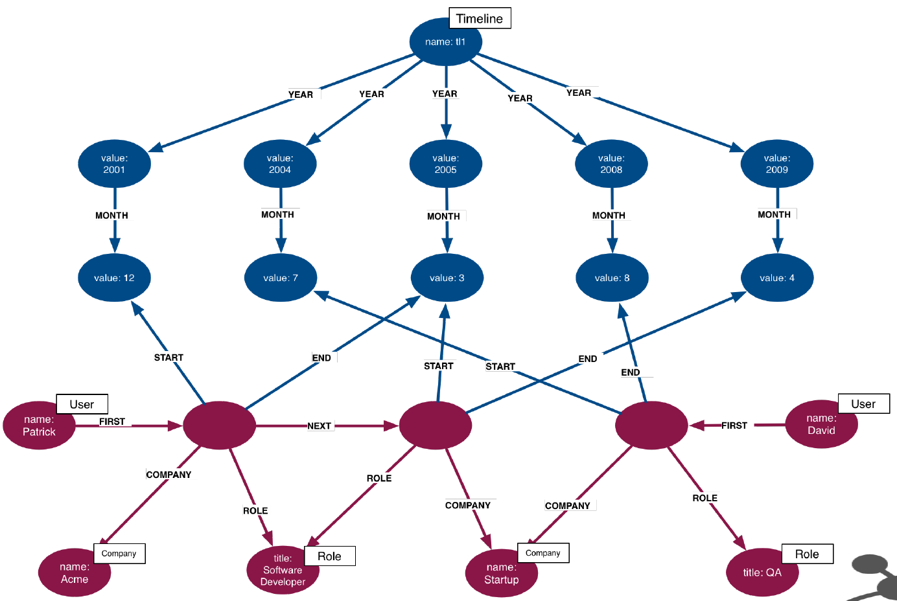
Intermediate nodes
IN_YEAR
IN_YEAR
IN_YEAR
IN_YEAR
IN_YEAR
IN_MONTH
IN_MONTH
IN_MONTH
IN_MONTH
IN_MONTH
STARTED
ENDED
STARTED
ENDED
STARTED
ENDED
AT_COMPANY
IN_ROLE
AT_COMPANY
IN_ROLE
AT_COMPANY
AT_COMPANY
IN_ROLE
Notes:
The relevant items connected to the timeline are Employment events, which link to the starting and ending months of that employment. Employment events themselves are intermediate nodes connecting people, companies, and job roles. In this case, the intermediate nodes are serving the dual purposes of reducing the density of Person nodes, and providing an attachment point for the timeline tree.

Slide 94
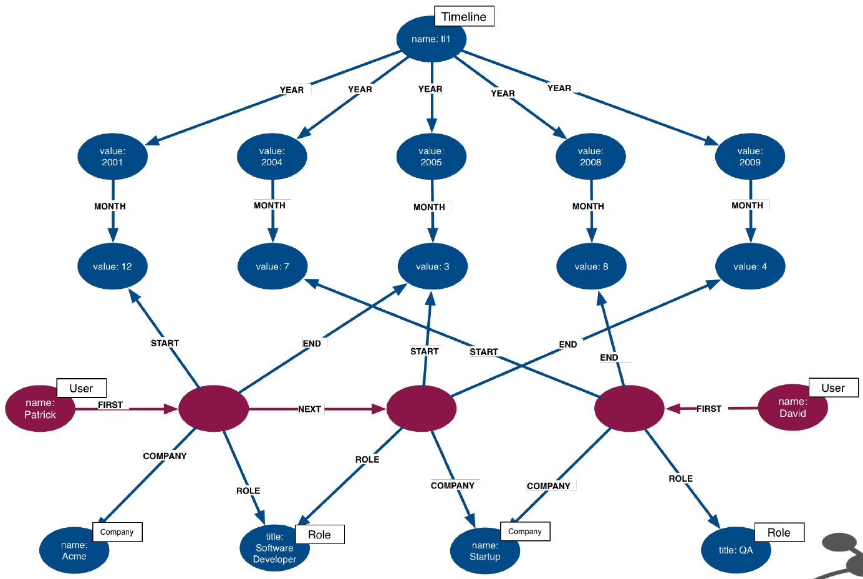
Linked list
IN_YEAR
IN_YEAR
IN_YEAR
IN_YEAR
IN_YEAR
IN_MONTH
IN_MONTH
IN_MONTH
IN_MONTH
IN_MONTH
STARTED
ENDED
STARTED
ENDED
STARTED
ENDED
AT_COMPANY
IN_ROLE
IN_ROLE
AT_COMPANY
AT_COMPANY
IN_ROLE
Notes:
Furthermore, the Employment events themselves are organized into linked lists for each person. This allows us to represent the sequence of employment events in an individual’s career.

Slide 95
Exercise 6:
Model a Learning Management System (LMS)

Slide 96
Exercise 6: The Domain
There are many courses in the LMS, each of which contains a number of lessons that must be completed in a specific order
Every course grants a certificate upon completion
This certificate has a term of validity. When it expires, students must take the course again
Students can enroll in as many simultaneous courses as they want
When a student logs in and chooses a course, the LMS must send them to their latest unfinished lesson

Slide 97
Exercise 6: Sample data
Courses | Lessons | Certificate
Introduction to Neo4j | Graph Theory, Graph Databases, Basic Cypher | 2-year validity
Neo4j for Developers | Graph Theory, Property Graph, Graph Databases | 6-month validity
Students | Completed Courses | In-Progress Courses
Alice | Introduction to Neo4j (2016), Introduction to Neo4j (2018) | Introduction to Neo4j (lesson 1)
Dan |  | Introduction to Neo4j (lesson 3), Neo4j for Developers (lesson 2)

Slide 98
Exercise 6: Application questions
Which lesson(s) is Dan currently working on?
What are Alice’s current certifications?
Which lessons are in the Neo4j for Developers course?
What is the last lesson in the Introduction to Neo4j course?
Which lesson follows Graph Theory in the Neo4j for Developers course?
Who has completed Introduction to Neo4j?

Slide 99
Exercise 6
Which lesson(s) is Dan currently working on?
What are Alice’s current certifications?
Which lessons are in the Neo4j for Developers course?
What is the last lesson in the Introduction to Neo4j course?
Which lesson follows Graph Theory in the Neo4j for Developers course?
Who has completed Introduction to Neo4j?
Courses | Lessons | Certificate
Introduction to Neo4j | Graph Theory, Graph Databases, Basic Cypher | 2-year validity
Neo4j for Developers | Graph Theory, Property Graph, Graph Databases | 6-month validity
Students | Completed Courses | In-Progress Courses
Alice | Introduction to Neo4j (2016), Introduction to Neo4j (2018) | Introduction to Neo4j (lesson 1)
Dan |  | Introduction to Neo4j (lesson 3), Neo4j for Developers (lesson 2)
Notes:
We provided the domain, sample data, and application questions on your behalf. Complete the rest of the data modeling process on your own (identify entities, identify connections, test the model). Use Arrows to whiteboard your model www.apcjones.com/arrows Look out for any use cases for the common graph structures we just discussed. ****** INSTRUCTOR NOTES:
If students feel overwhelmed, ask them to break down the problem. First model the course content, and only then add in the student interaction. Ask students to share their model as soon as they have a working “prototype.” Emphasize that model-building is iterative. If their model is imperfect, rather than telling them the better model, ask them questions that expose the weaknesses of their model relative to the application questions. Do this exercise yourself in Arrows also. To save clicks and typing, use this markup:
<ul class="graph-diagram-markup" data-internal-scale="0.67" data-external-scale="1">
<li class="node" data-node-id="0" data-x="-550.4655813128935" data-y="-1216.8149073094257">
<span class="caption">Student</span>
</li>
<li class="node" data-node-id="1" data-x="592.2255987630683" data-y="-808.4017464284152">
<span class="caption">Enrollment</span><dl class="properties"><dt>certExpiration</dt><dd>date</dd></dl></li>
<li class="node" data-node-id="2" data-x="1530.5288281421945" data-y="-188.47328130455">
<span class="caption">Course</span>
</li>
<li class="node" data-node-id="3" data-x="696.1411792240782" data-y="475.60253854551536">
<span class="caption">Lesson</span>
</li>
<li class="node" data-node-id="4" data-x="1562.4419933343002" data-y="475.60253854551536">
<span class="caption">Lesson</span>
</li>
<li class="node" data-node-id="5" data-x="2419.99523773733" data-y="475.60253854551536">
<span class="caption">Lesson</span>
</li>
<li class="node" data-node-id="6" data-x="2459.771940162705" data-y="-808.4017464284152">
<span class="caption">Certificate</span><dl class="properties"><dt>validForMonths</dt><dd>integer</dd></dl></li>
<li class="relationship" data-from="4" data-to="5">
<span class="type">NEXT_&lt;course&gt;</span>
</li>
<li class="relationship" data-from="3" data-to="4">
<span class="type">NEXT_&lt;course&gt;</span>
</li>
<li class="relationship" data-from="2" data-to="3">
<span class="type">FIRST</span>
</li>
<li class="relationship" data-from="2" data-to="5">
<span class="type">LAST</span>
</li>
<li class="relationship" data-from="0" data-to="1">
<span class="type">HAS_ENROLLMENT</span>
</li>
<li class="relationship" data-from="1" data-to="2">
<span class="type">IN_COURSE</span>
</li>
<li class="relationship" data-from="2" data-to="6">
<span class="type">HAS_CERTIFICATE</span>
</li>
<li class="relationship" data-from="1" data-to="6">
<span class="type">EARNED_CERTIFICATE</span>
</li>
<li class="relationship" data-from="1" data-to="4">
<span class="type">COMPLETED</span>
</li>
</ul>

Slide 100
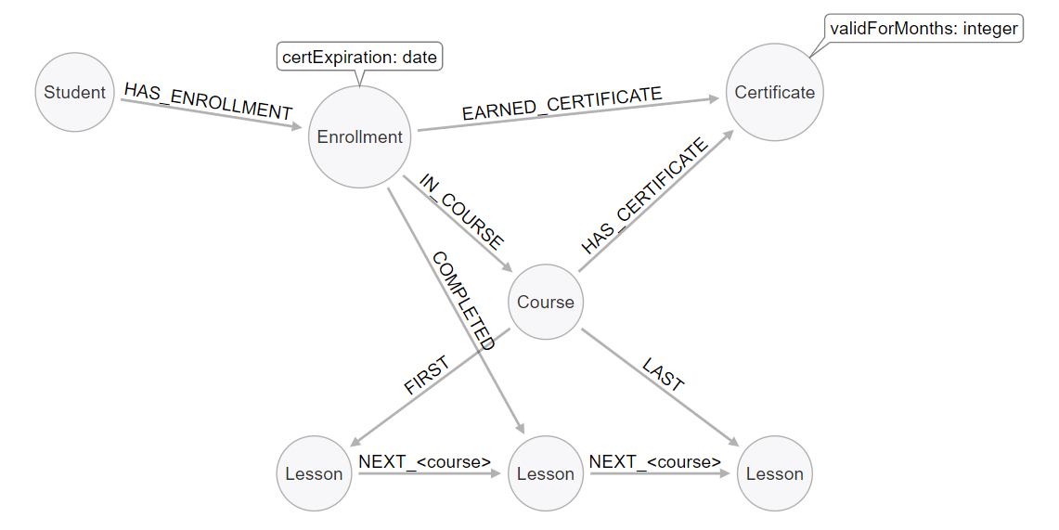
Exercise 6: Solution Model
Notes:
The Course and Lessons are structured as a linked list with a parent. We include the course name in the NEXT relationship, because some lessons are used by multiple courses, but in a different order. In other words, we have an interleaved linked list, and need to distinguish the different sequences.
Courses are associated with a Certificate, which contains, among other things, a term of validity expressed here in months. Students do not directly interact with courses or lessons. Instead, we use an Enrollment intermediate node to organize their interactions. Enrollments are linked to a single course and contain a pointer to which lesson was most recently completed. When a COMPLETED relationship is created with the lesson marked LAST in a given course, that is the trigger to create an EARNED_CERTIFICATE relationship. AT this point, the certExpiration property will be populated by adding the term of validity to the current timestamp. This intermediate node allows us to keep track of students’ progress through different concurrent courses, and to differentiate multiple subsequent passes through the same course.

Slide 101
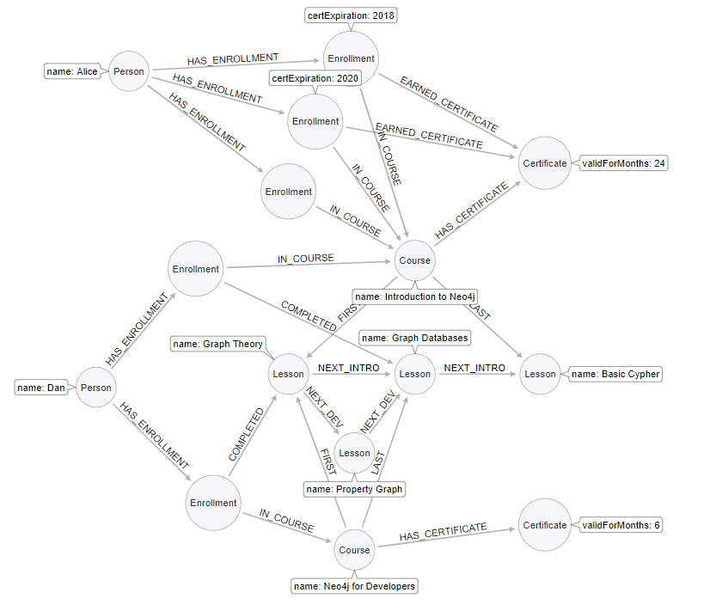
Exercise 6: Sample Data
Which lesson(s) is Dan currently working on?
What are Alice’s current certifications?
Which lessons are in the Neo4j for Developers course?
What is the last lesson in the Introduction to Neo4j course?
Which lesson follows Graph Theory in the Neo4j for Developers course?
Who has completed Introduction to Neo4j?
Notes:
Here is the sample data fully fleshed out. Use the below markup to get it into Arrows. As a group, prompt students to trace the traversal for each of the application questions, in order to verify that the model serves the questions. *********** <ul class="graph-diagram-markup" data-internal-scale="0.21" data-external-scale="1">
<li class="node" data-node-id="0" data-x="-396.2973779224105" data-y="-1598.542651644388">
<span class="caption">Person</span><dl class="properties"><dt>name</dt><dd>Alice</dd></dl></li>
<li class="node" data-node-id="1" data-x="696.1411792240782" data-y="-775.5184522555546">
<span class="caption">Enrollment</span>
</li>
<li class="node" data-node-id="2" data-x="1562.4419933343002" data-y="-301.66353654081996">
<span class="caption">Course</span><dl class="properties"><dt>name</dt><dd>Introduction to Neo4j</dd></dl></li>
<li class="node" data-node-id="3" data-x="696.1411792240782" data-y="475.60253854551536">
<span class="caption">Lesson</span><dl class="properties"><dt>name</dt><dd>Graph Theory</dd></dl></li>
<li class="node" data-node-id="4" data-x="1562.4419933343002" data-y="475.60253854551536">
<span class="caption">Lesson</span><dl class="properties"><dt>name</dt><dd>Graph Databases</dd></dl></li>
<li class="node" data-node-id="5" data-x="2419.99523773733" data-y="475.60253854551536">
<span class="caption">Lesson</span><dl class="properties"><dt>name</dt><dd>Basic Cypher</dd></dl></li>
<li class="node" data-node-id="6" data-x="2452.0596471356525" data-y="-970.0863461358005">
<span class="caption">Certificate</span><dl class="properties"><dt>validForMonths</dt><dd>24</dd></dl></li>
<li class="node" data-node-id="7" data-x="879.8886791627793" data-y="-1253.5663862086055">
<span class="caption">Enrollment</span><dl class="properties"><dt>certExpiration</dt><dd>2020</dd></dl></li>
<li class="node" data-node-id="8" data-x="1124.3637964049385" data-y="-1683.353885999956">
<span class="caption">Enrollment</span><dl class="properties"><dt>certExpiration</dt><dd>2018</dd></dl></li>
<li class="node" data-node-id="9" data-x="-591.3704658622172" data-y="-2730.474279887639"></li>
<li class="node" data-node-id="10" data-x="-620.4774799631609" data-y="565.4384413761886">
<span class="caption">Person</span><dl class="properties"><dt>name</dt><dd>Dan</dd></dl></li>
<li class="node" data-node-id="11" data-x="1148.4184037393607" data-y="1678.755606466262">
<span class="caption">Course</span><dl class="properties"><dt>name</dt><dd>Neo4j for Developers</dd></dl></li>
<li class="node" data-node-id="12" data-x="1148.4184037393607" data-y="1015.6712674382908">
<span class="caption">Lesson</span><dl class="properties"><dt>name</dt><dd>Property Graph</dd></dl></li>
<li class="node" data-node-id="13" data-x="-81.87263599082607" data-y="1955.3561577156422"></li>
<li class="node" data-node-id="14" data-x="61.062009896806536" data-y="-246.0263961108761">
<span class="caption">Enrollment</span>
</li>
<li class="node" data-node-id="15" data-x="181.74861463859963" data-y="1357.3756722976887">
<span class="caption">Enrollment</span>
</li>
<li class="node" data-node-id="16" data-x="2452.0596471356525" data-y="1507.105178106398">
<span class="caption">Certificate</span><dl class="properties"><dt>validForMonths</dt><dd>6</dd></dl></li>
<li class="relationship" data-from="4" data-to="5">
<span class="type">NEXT_INTRO</span>
</li>
<li class="relationship" data-from="3" data-to="4">
<span class="type">NEXT_INTRO</span>
</li>
<li class="relationship" data-from="2" data-to="3">
<span class="type">FIRST</span>
</li>
<li class="relationship" data-from="2" data-to="5">
<span class="type">LAST</span>
</li>
<li class="relationship" data-from="0" data-to="1">
<span class="type">HAS_ENROLLMENT</span>
</li>
<li class="relationship" data-from="1" data-to="2">
<span class="type">IN_COURSE</span>
</li>
<li class="relationship" data-from="2" data-to="6">
<span class="type">HAS_CERTIFICATE</span>
</li>
<li class="relationship" data-from="0" data-to="7">
<span class="type">HAS_ENROLLMENT</span>
</li>
<li class="relationship" data-from="0" data-to="8">
<span class="type">HAS_ENROLLMENT</span>
</li>
<li class="relationship" data-from="7" data-to="2">
<span class="type">IN_COURSE</span>
</li>
<li class="relationship" data-from="8" data-to="2">
<span class="type">IN_COURSE</span>
</li>
<li class="relationship" data-from="8" data-to="6">
<span class="type">EARNED_CERTIFICATE</span>
</li>
<li class="relationship" data-from="7" data-to="6">
<span class="type">EARNED_CERTIFICATE</span>
</li>
<li class="relationship" data-from="3" data-to="12">
<span class="type">NEXT_DEV</span>
</li>
<li class="relationship" data-from="12" data-to="4">
<span class="type">NEXT_DEV</span>
</li>
<li class="relationship" data-from="11" data-to="3">
<span class="type">FIRST</span>
</li>
<li class="relationship" data-from="11" data-to="4">
<span class="type">LAST</span>
</li>
<li class="relationship" data-from="10" data-to="14">
<span class="type">HAS_ENROLLMENT</span>
</li>
<li class="relationship" data-from="10" data-to="15">
<span class="type">HAS_ENROLLMENT</span>
</li>
<li class="relationship" data-from="15" data-to="11">
<span class="type">IN_COURSE</span>
</li>
<li class="relationship" data-from="14" data-to="2">
<span class="type">IN_COURSE</span>
</li>
<li class="relationship" data-from="15" data-to="3">
<span class="type">COMPLETED</span>
</li>
<li class="relationship" data-from="14" data-to="4">
<span class="type">COMPLETED</span>
</li>
<li class="relationship" data-from="11" data-to="16">
<span class="type">HAS_CERTIFICATE</span>
</li>
</ul>

Slide 102
Thank you!

Slide 103
Refactoring / Evolving a Model
v 1.0

Slide 104
What is refactoring?
Refactoring is the process of changing the data structure without altering its semantic meaning
Most of the time, refactoring simply involves moving data from one structure to another within the graph
In some cases, refactoring involves adding more data from outside

Slide 105
Review: Hierarchy of Accessibility
For each data object, how much work must Neo4j do to evaluate if this is a “good” path or a “bad” one?
Most accessible Least processing required
Anchor node label Anchor node properties (indexed)
Relationship type
Anchor node properties (non-indexed)
Downstream node labels
Relationship properties Downstream node properties
Anchor Node
Downstream Nodes
Least accessible Most processing required
Notes:
Recall the hierrarchy of accessibility. In general, refactoring involves moving data around this hierarchy, in order to better answer a question.

Slide 106
Why refactor?
Data models can be optimized for one of four things:
Query performance
Model simplicity & intuitiveness
Query simplicity (i.e., simpler Cypher strings)
Easy data updates
Improving behavior in one of these areas frequently involves sacrifices in others
Another reason to refactor:
Accommodating new application questions in the same model

Slide 107
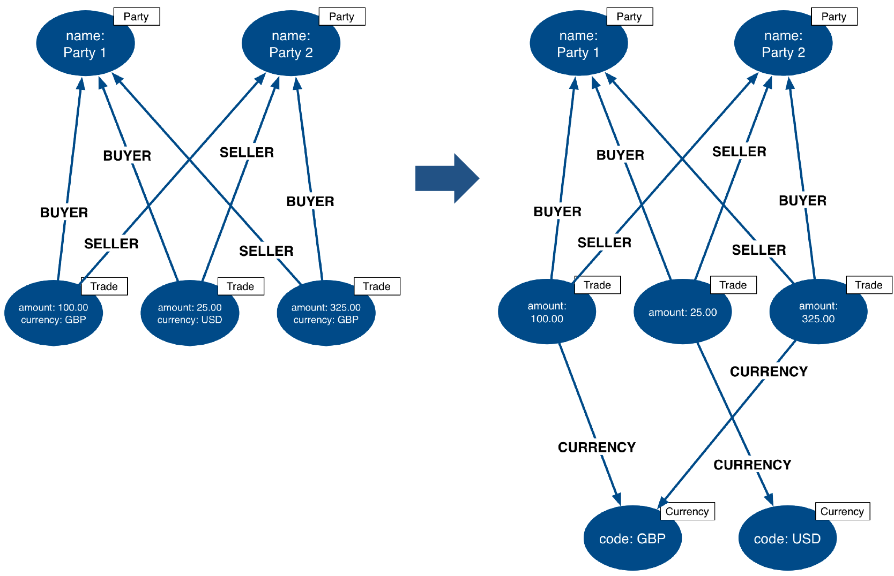
Example: Extract node from a property
BOUGHT_BY
SOLD_BY
BOUGHT_BY
SOLD_BY
BOUGHT_BY
BOUGHT_BY
BOUGHT_BY
BOUGHT_BY
SOLD_BY
SOLD_BY
SOLD_BY
SOLD_BY
USES_CURRENCY
USES_CURRENCY
USES_CURRENCY
Notes:
We’ve already seen some examples of this kind of refactoring. If, we split Currency onto its own node. This allows us to anchor on Currency, if desired, and reduces the amount of properly lookups we need to do in other cases

Slide 108
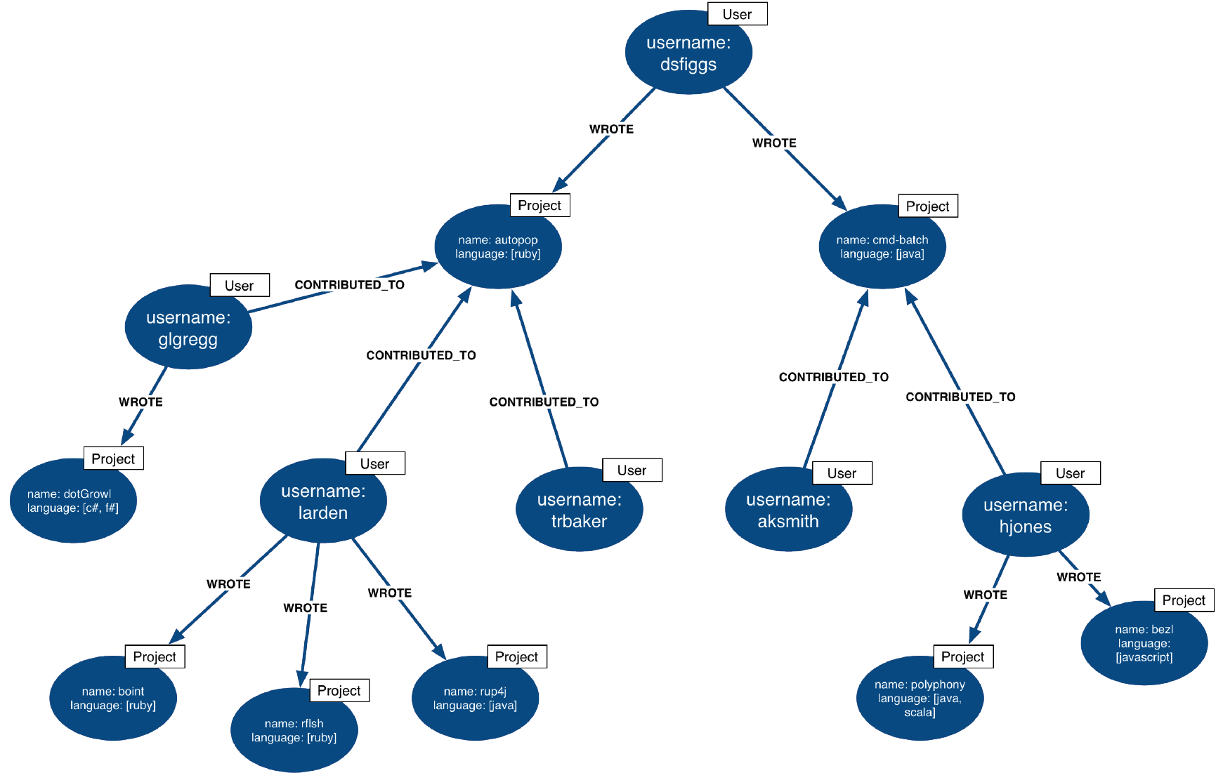
Example: Convert property to label
Project, ruby
Project, java
Project, cSharp, fSharp
Project, javascript
Project, ruby
Project, java
Project, java, scala
Project, ruby
Notes:
Converting a repeated property to a Label is another common refactor.

Slide 109
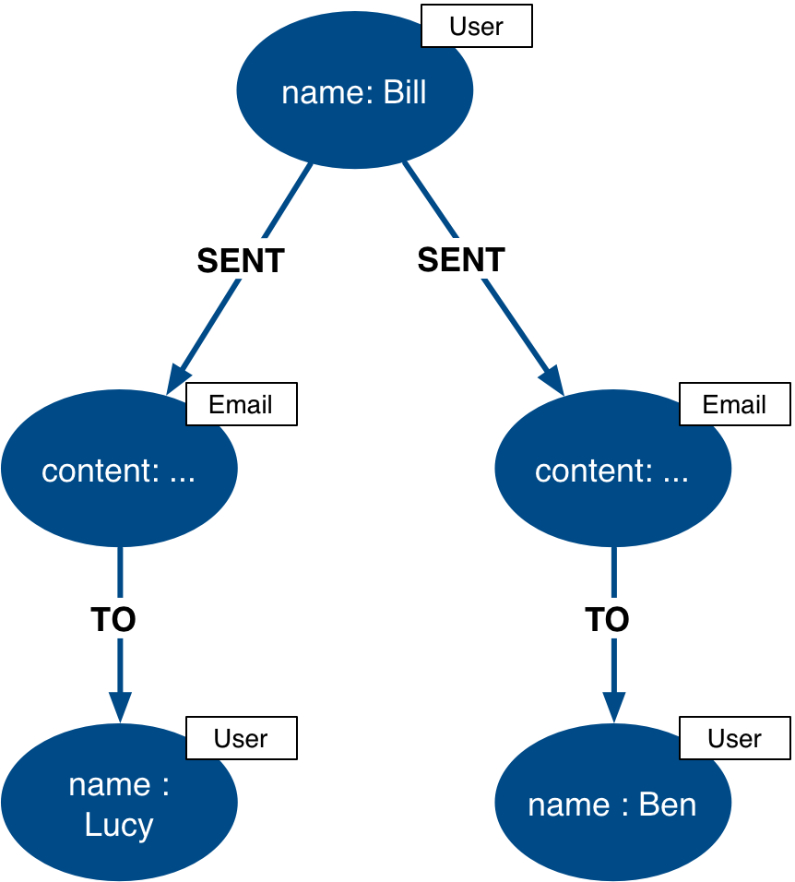
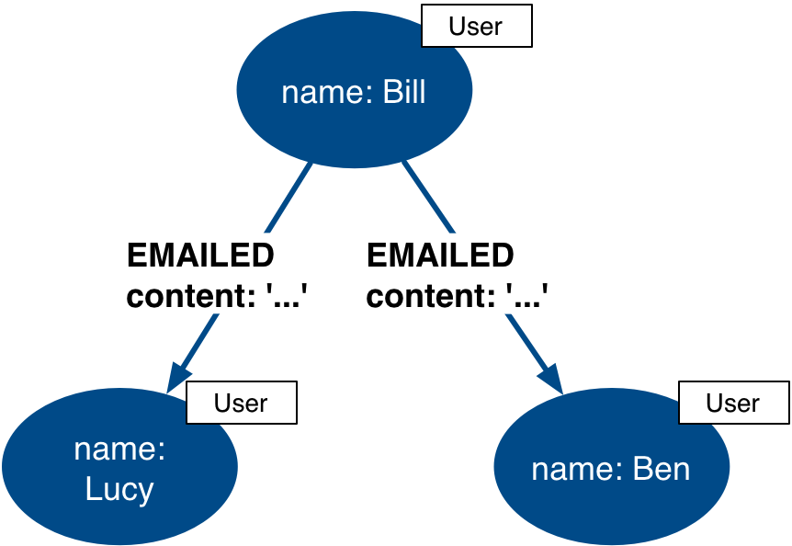
Example: Extract intermediate nodes
Notes:
Intermediate nodes are also a frequent result of refactoring. What was previously a relationship property is now a node property, which is not necessarily any more accessible from a query processing standpoint. But it makes the model simpler by reducing the number of relationships connected to each Person node.

Slide 110
Refactoring example

Slide 111
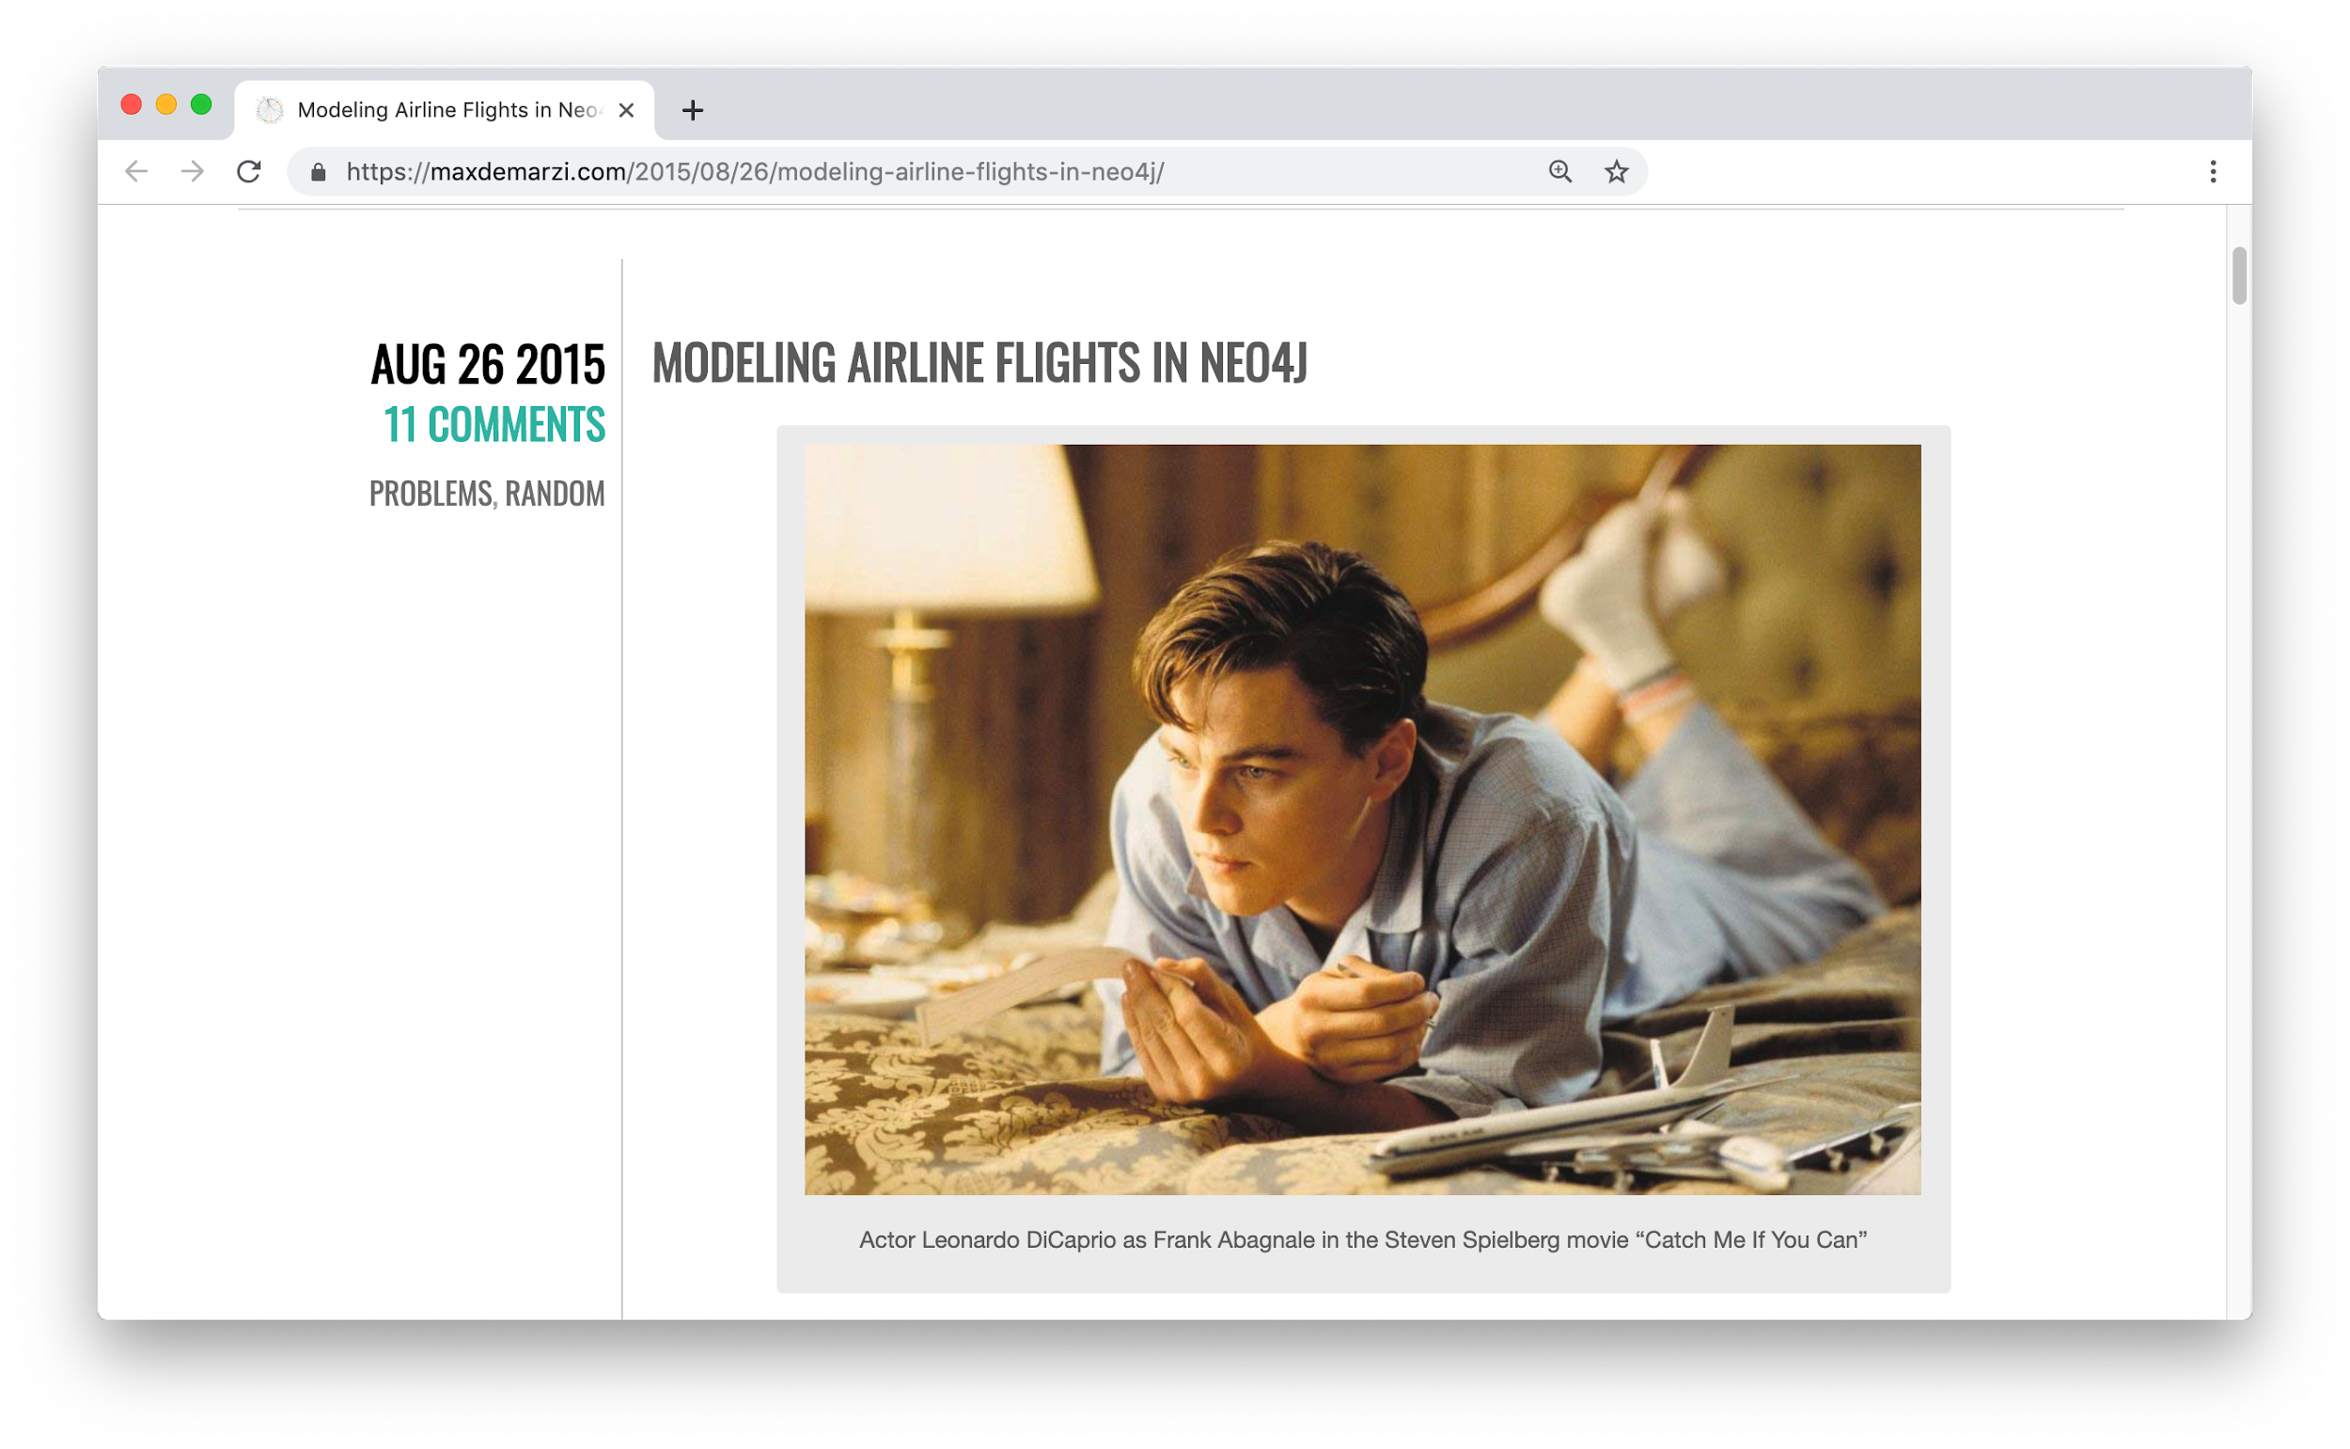
Modeling airline flights in Neo4j
Credit: Max de Marzii https://maxdemarzi.com/2015/08/26/modeling-airline-flights-in-neo4j/
Notes:
We will now walk through an iterative process of graph development and refactoring. We will use, as an example, modeling airline flights for an Orbitz-style use case: that is, answering the problem, “I want to fly from Malmo to New York on Friday”
You can read in depth about this on Max’s blog, linked here.

Slide 112
Initial model
Q: What flights will take me from Malmo to New York on Friday?
What entities do we see?
What connections do we see?
What properties do we need?
Notes:
Model this part of the class interactively. Pose each stage as questions for the class to answer. Here, we begin by following the modeling process: identifying entities and connection based on the question. The entities should be Airports, and the connections FLYING_TO, with one connection per flight. Airport data like city and flight data like airline, flight number, departure, etc. are necessary properties. That leads us to our first model , on the next slide.

Slide 113
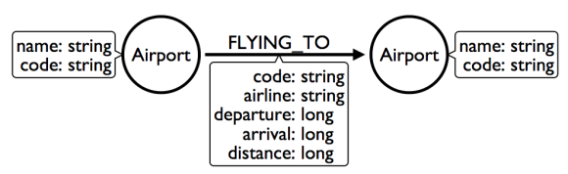
Initial model
Q: What flights will take me from Malmo to New York on Friday?
new Q: Someone is on flight AY189. When will she/he land?
Notes:
This model answers the first question just fine. But suppose we had to answer a different question, like this one? Mom is on flight AY189. When will she land?
What must Neo4j traverse to find this answer? This is a painful one--in order to find AY189, Neo4j needs to traverse every relationship in the graph, because it is impossible to anchor on relationships. What can we do to make flight data available as an anchor?

Slide 114
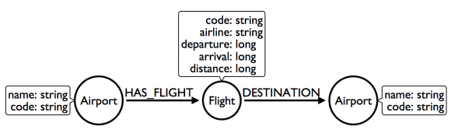
Add Flight intermediate nodes
Q1: What flights will take me from Malmo to New York on Friday?
Q2: Someone is on flight AY189. When will he/she land?
Notes:
This is the perfect use case for an intermediate node. Adding Flight nodes allows us to anchor on flight data, dramatically reducing traversal.
But I’m still not satisfied with the way we’re handling Q1. Airlines are required to publish flight plans 12 months or more in advance.
How much work must Neo4j do to answer Q1? Again, the answer is painful. Neo4j must check every flight leaving Malmo, then consult the Flight node data to see which ones leave on the appropriate day. That’s even before we check to see which of those flights land in the desired place! How can we elevate the flight date in order to reduce the amount of wasted hops?

Slide 115
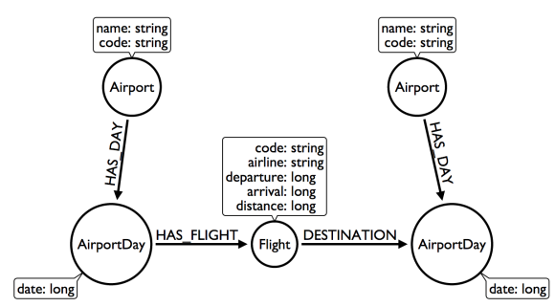
Add AirportDay intermediate nodes
Q1: What flights will take me from Malmo to New York on Friday?
Q2: Someone is on flight AY189. When will she/he land?
Notes:
Again, intermediate nodes come to the rescue.
AirportDay nodes reduce the density of Airport nodes, as there are many fewer days in the graph than there are flights.
We still need to check every Airport Day to find the right date, but the scope of wasted traversal is lessened. Whenever we execute a model change, we also need to check that our older queries are not disrupted. What about Q2? As long as we continue to be able to anchor on Flight, Q2 is unaffected. This refactor causes no problems. But thinking more on Q1. How might we arrange things to reduce wasted traversal even further? In other words, how might we elevate flight date even higher on the hierarchy of accessibility? There are only two to do this: either anchor somehow on AirportDay, or make date into a relationship type. Let’s see what the second one looks like.

Slide 116
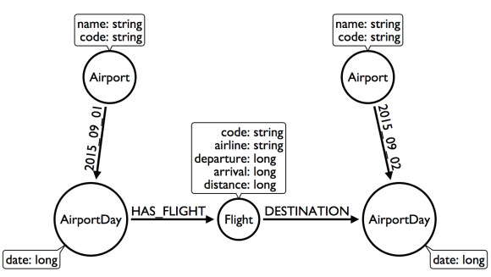
Change relationship type to Date
Q1: What flights will take me from Malmo to New York on Friday?
Q2: Mom is on flight AY189. When will she land?
Notes:
Date-as-Type hardly changes the model at all, with drastic performance improvements. Now, we can traverse only to the relevant AirportDay. Again, Q2 is unaffected. This is one of the two solutions we had.
The other was to anchor on AirportDay. How would the model need to change to make that possible?

Slide 117
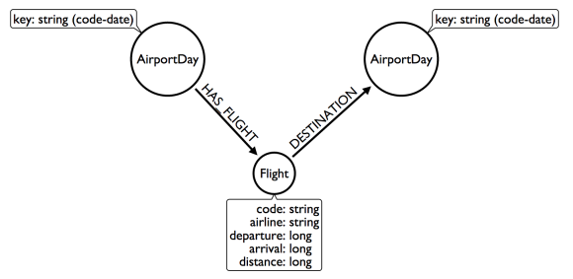
Remove Airport nodes
Q1: What flights will take me from Malmo to New York on Friday?
Q2: Mom is on flight AY189. When will she land?
Notes:
We could eliminate the Airport nodes entirely, and store airport data on the AirportDay nodes. This shrinks the graph by removing a modest number of Airport nodes, and a large number of Date-typed HAS_DAY relationships. This also performs 2 fewer hops per traversal--a tiny improvement, but one that could add up at scale. We’d need to test this benefit more rigorously in production. The downside to this model is that it is far less intuitive to a human looking at it. As mentioned earlier, refactoring is rarely pure positive; the gains you make in one area often involve sacrifices in others.
********* So we have a model that seems to work well for Q1. But we’ve been making one dangerous assumption: that there is a direct flight available. What will Neo4j need to do in order to find an itinerary with 2, 3, 4, or more legs? This is an expensive problem for this model. Neo4j will traverse every flight leaving that day and look at destinations. But in the non-direct case, none of the destinations is the correct one. So Neo4j will need to check all the HAS_FLIGHT relationships on those destinations and see if the second-order destinations include the desired one. If that isn't the case, repeat until you find the desired destination. The size of the traversed graph increases exponentially as more and more layovers are added. What can we do to reduce this?

Slide 118
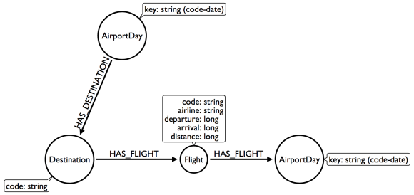
Add Destination intermediate nodes
Q1: What flights will take me from Malmo to New York on Friday?
Q2: Mom is on flight AY189. When will she land?
Notes:
Once again, Intermediate nodes to the rescue! In this case, we’re doing two things, further subdividing flights based on destination, but more importantly, we are elevating flight destinations form a 3-hop downstream object to a 1-hop downstream object. How does the non-direct traversal work in this case? First, Neo4j will check every Destination served by that AirportDay. If the target destination is not there, follow ONE Flight chain to the Airport Day of the destination, then check the served Destinations of that AirportDay. The scope of the graph still grows, but it grows at a rate proportional to the number of Destinations served by an airport, not the number of Flights. And airports tend to have multiple flights per destination, leaving at different times of day. Once an itinerary leading to the target destination is found, Neo4j can branch out and traverse all the flights connecting those AirportDays ********* As always, we must consider: how does this refactor affect Q2? Once again, the answer is that it does not--we can still anchor on Flight, so Q2 is not disrupted. ********** Note that this model could never have been produced by simply following our “build initial model” paradigm. AirportDay and Destination nodes are completely opaque relative to the questions we asked. We’re OK with that, because, as you will see in the Implementation portion of the course, refactoring a graph relatively cheap. Moreover, getting a rough first model quickly reduces the total time we’d need to reach this more refined version.

Slide 119
Thank you!

Slide 120
Implementing
Your First Airport Model
v 1.0

Slide 121
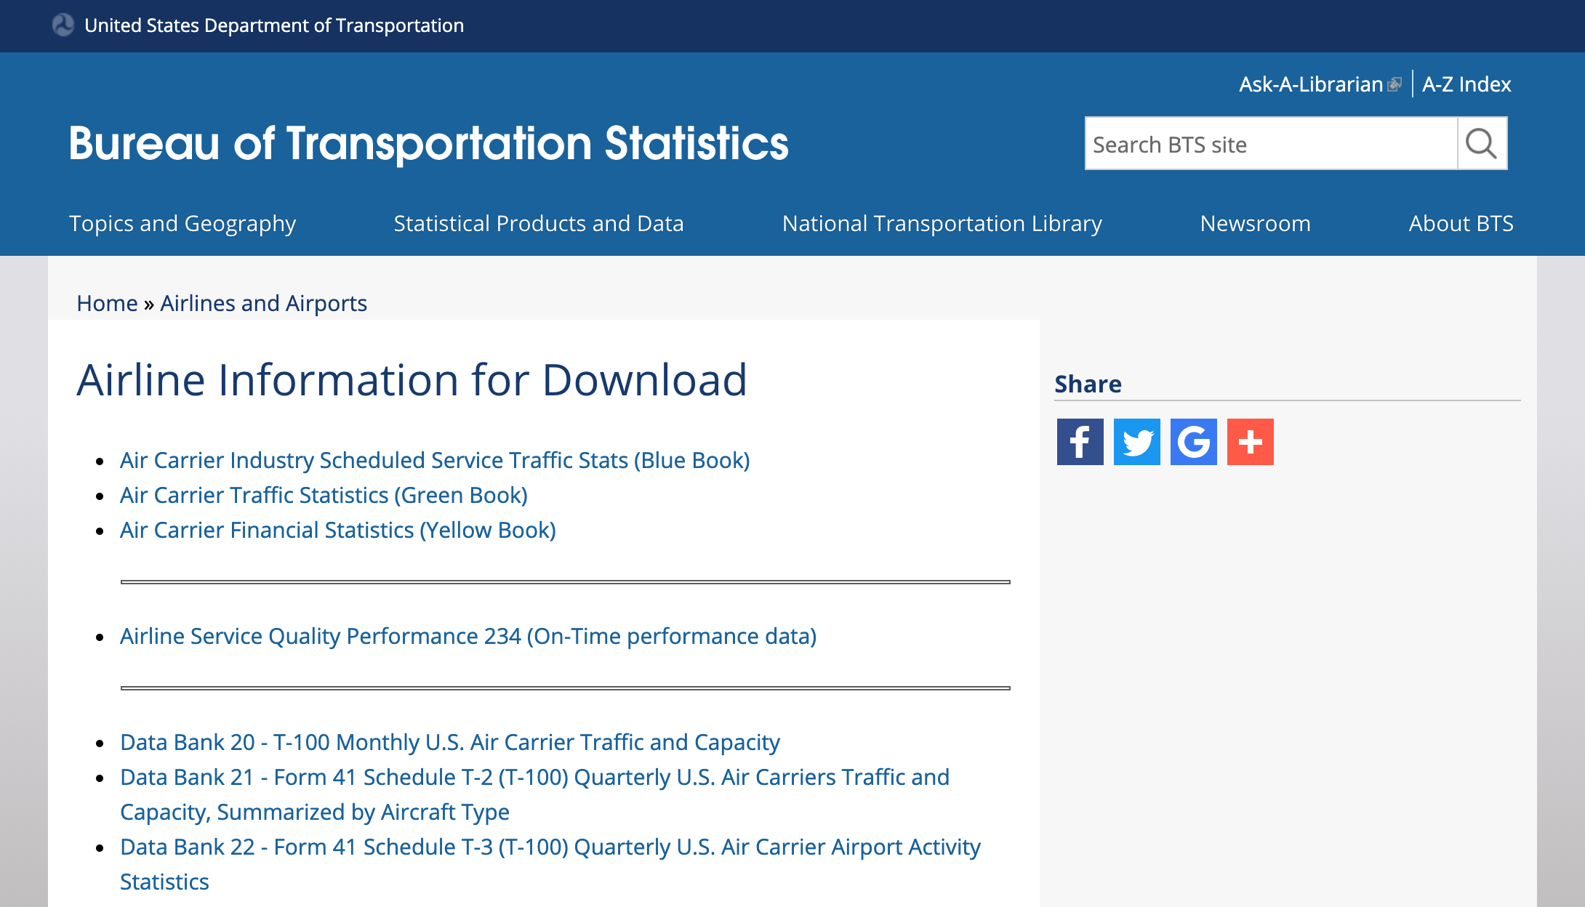
Domain for this module
Notes:
For the remainder of this training we’re going to work in a familiar domain, airplane flights. We are working in a familiar domain so that we can focus on implementation details, and not be distracted by wider concepts. Specifically, we will use a dataset from the US Bureau of Transportation.

Slide 122
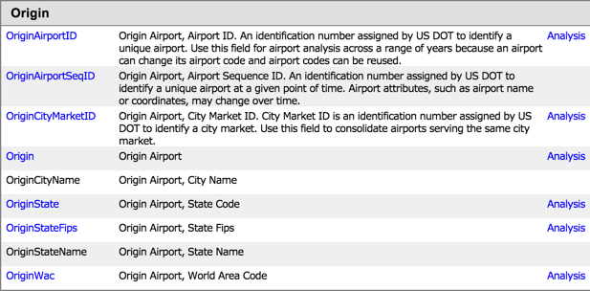
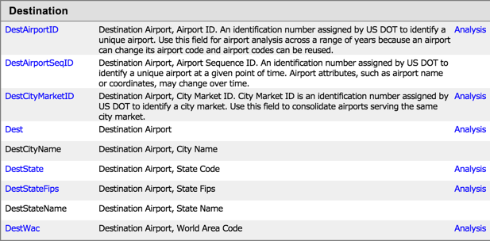
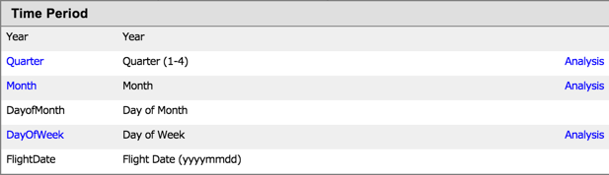
The Data
Notes:
The data itself is quite rich. We won’t make use of every part of it in these exercises, but you can check it out if you have spare time during the execrises.

Slide 123
Application question for our model
As an air travel enthusiast
I want to know how airports are connected
So that I can find the busiest ones
Notes:
What entities do you see? What connections? What properties are needed?

Slide 124
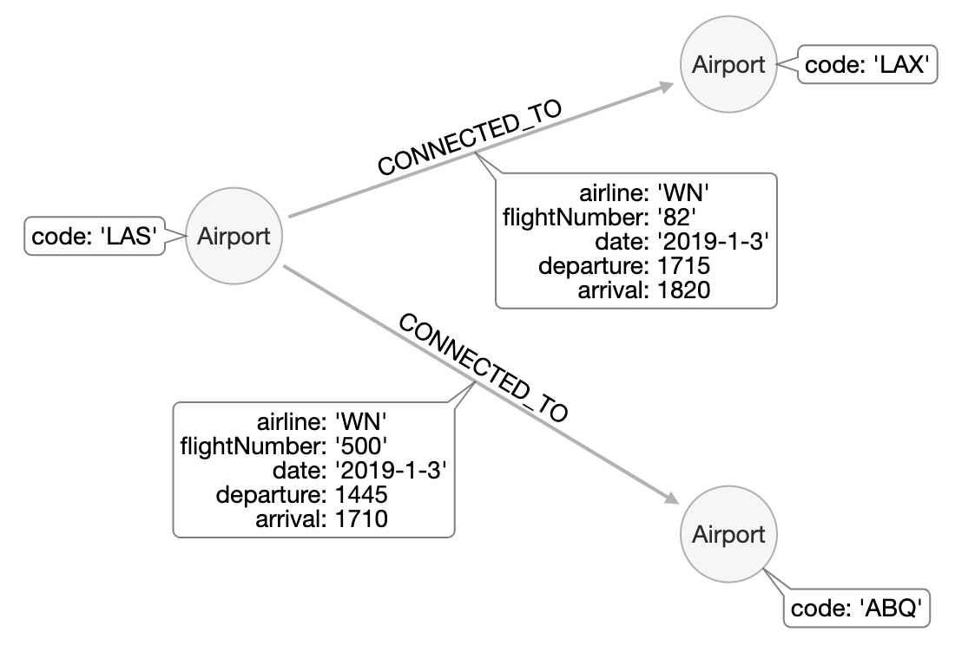
Initial model with sample data
As an air travel enthusiast
I want to know how airports are connected
So that I can find the busiest ones
Notes:
When we worked with flights conceptually earluier, we started with a simple Airport CONNECTED_TO Airport mode. That suits this initial question just fine.

Slide 125
Working with the sample data
A best practice when creating a graph with Cypher is to use the MERGE statement. This ensures that you will not create duplicate nodes or relationships in the graph.
In the next exercise, Exercise 2, you will:
Create three Airport nodes and two CONNECTED_TO relationships per the initial data model by using the MERGE statement.
Query the graph to show the newly-created nodes and relationships.
Creating the nodes and relationships using the MERGE statement and hard-coding values is fine for small sample of data, but once you start working with larger amounts of data, you will want to load the data (typically from CSV files).

Slide 126
Exercise 2:
Getting started with
the airport graph data model
In Neo4j Browser:
:play neo4j-modeling-exercises
Then follow instructions for Exercise 2.
Notes:
While the students are working on this exercise, create the airports in the database using this Cypher:
CREATE
(`0` :Airport {code:'LAS'}) ,
(`1` :Airport {code:'LAX'}) ,
(`2` :Airport {code:'ABQ'}) ,
(`0`)-[:`CONNECTED_TO` {airline:'WN',flightNumber:'82',date:'2019-1-3',departure:'1715',arrival:'1820'}]->(`1`),
(`0`)-[:`CONNECTED_TO` {airline:'WN',flightNumber:'500',date:'2019-1-3',departure:'1445',arrival:'1710'}]->(`2`)

Slide 127
Thank you!

Slide 128
Importing Bulk Data
v 1.0

Slide 129
LOAD CSV
Cypher statement used to load a moderate ( < 10K rows) amount of data into a graph.
LOAD CSV // load csv data
WITH HEADERS // optionally use first header row as keys in "row" map
FROM "url" // file:// URL relative to $NEO4J_HOME/import or http://
AS row // return each row of the CSV as list of strings or map
// ... rest of the Cypher statement ...
Note: You should use PERIODIC COMMIT or the APOC library for loading larger amounts of data which you will do later in this course.
Notes:
You should always work with CSV files with headers (or a separate header file). See the documentation for details about working with CSV files.

Slide 130
Importing CSV data
Copy CSV files to the import folder associated with the database you are working with.
Hint: File locations vary by platform and how you installed Desktop.
Execute this Cypher statement to examine the first 5 rows of the data.
LOAD CSV WITH HEADERS FROM 'file:///flights_2019_1k.csv' AS row
RETURN row LIMIT 5
Notes:
You should always work with CSV files with headers (or a separate header file). See the documentation for details about working with CSV files.
In addition, working the CSV files was covered in the course, Introduction to Neo4j.

Slide 131
Exercise 3:
Loading airport data
In Neo4j Browser:
:play neo4j-modeling-exercises
Then follow instructions for Exercise 3.
Notes:
The student will now load data from a CSV file, flights_2019_1k.csv. The schema has not changed, but the amount of data the student is working with has.
While the students are working on this exercise, make sure you have loaded flights_2019_1k.csv into your database as you want to have the same data in your graph that the students are working with. Here is the Cypher statement:
LOAD CSV WITH HEADERS FROM 'file:///flights_2019_1k.csv' AS row
MERGE (origin:Airport {code: row.Origin})
MERGE (destination:Airport {code: row.Dest})
MERGE (origin)-[connection:CONNECTED_TO {
airline: row.UniqueCarrier,
flightNumber: row.FlightNum,
date: toInteger(row.Year) + '-' + toInteger(row.Month) + '-' + toInteger(row.DayofMonth)}]->(destination)
ON CREATE SET connection.departure = toInteger(row.CRSDepTime), connection.arrival = toInteger(row.CRSArrTime)

Slide 132
Profiling Queries
v 1.0

Slide 133
Profiling queries
Profiling is a vital part of the Testing step in the data modeling workflow|
Load data into the graph
Create queries that answer the application questions.
Execute the queries against the data
PROFILE the query execution. Identify problems and weaknesses
If necessary, modify the model and refactor the graph.
PROFILE the same type of query against the refactored graph.
Note: The new query may not be the same as the original, due to the change in the graph data model.

Slide 134
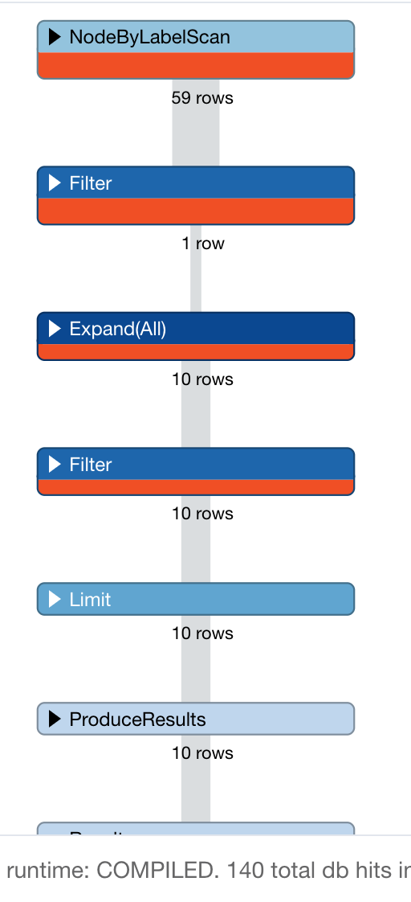
Example: Profiling a query
PROFILE
MATCH (origin:Airport)-
[c:CONNECTED_TO]->(destination:Airport)
WHERE destination.code = 'LAS'
RETURN origin, destination, c LIMIT 10
Notes:
To execute a PROFILE, simple append the PROFILE command to the beginning of your Cypher string. This executes the query as normal, but gives a different output, which shows every step in the query execution plan, and how much each step cost. With PROFILE, the main currency we consider is db hits. Execution time is important, but that is generally a result of administrative factors, like bandwidth, memory, and traffic volume. DB hits, on the other hand, are entirely a function of the data model and query string.

Slide 135
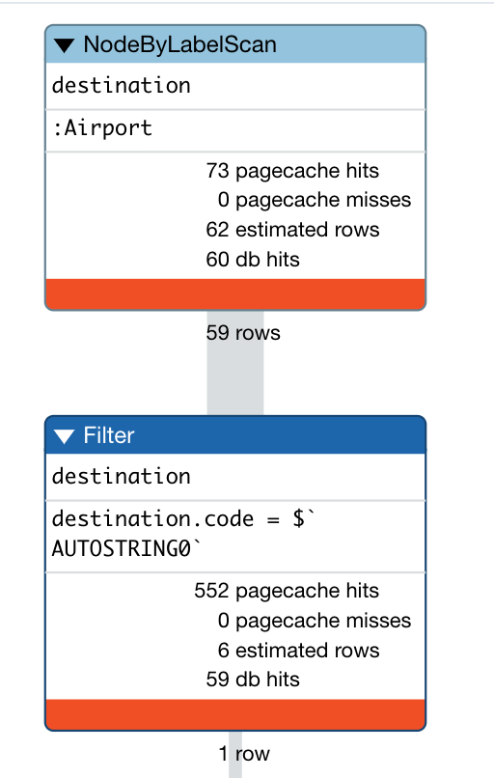
Analyzing the query profile (1)
PROFILE
MATCH (origin:Airport)-
[c:CONNECTED_TO]->(destination:Airport)
WHERE destination.code = 'LAS'
RETURN origin, destination, c LIMIT 10
Rows come in
Do some work
Rows go out
Notes:
The first step in any query is locating the anchor. In this case, Neo4j will anchor on the destination node set, because that one has a property filter while origin does not. According to the PROFILE, the anchor was located by first locating all Airport nodes under the Airport label, then scanning to find the desired code property value. This required 60 and 59 DB hits respectively and got us down to a single node--the perfect anchor set. ********* INSTRUCTOR’S NOTE This label scan + property scan is MUCH less efficient than an index lookup. We will observe that in a later exercise.

Slide 136

Analyzing the query profile (2)
PROFILE
MATCH (origin:Airport)-
[c:CONNECTED_TO]->(destination:Airport)
WHERE destination.code = 'LAS'
RETURN origin, destination, c LIMIT 10
Rows come in
Do some work
Rows go out
Notes:
With the anchor set identified, Neo4j then expanded along every incoming CONNECTED_TO relationship, finding 10 such paths with 11 DB hits. Next, Neo4j checked which of those paths terminated at an origin node labeled Airport. Based on what we know about our model, it is no surprise that all 10 paths qualified.
This is an example of providing an unnecessary filter. We could have dispensed with the Airport label on the origin set and saved 10 DB hits.

Slide 137

Analyzing the query profile (3)
Rows come in
PROFILE
MATCH (origin:Airport)-
[c:CONNECTED_TO]->(destination:Airport)
WHERE destination.code = 'LAS'
RETURN origin, destination, c LIMIT 10
Do some work
Rows go out
Notes:
With traversal finished, Neo4j then returned the results, filtered by the LIMIT clause. This operates entirely upon the objects already in memory, and so requires no DB hits. When all is said and done, you can see that total cost of this was 140 DB hits.
We could have saved 10 by not filtering on Airport for the origin nodes.
In addition, recall that identifying the anchor required 60+59 = 119 DB hits.
So our best opportunity for improving the performance of this query lies in finding a way to anchor more efficiently. PROFILE made that obvious, and we would have been unable to discover that by any other means.

Slide 138
Exercise 4:
Profiling queries
In Neo4j Browser:
:play neo4j-modeling-exercises
Then follow instructions for Exercise 4.

Slide 139


Do we need to change the model?
Question: What are the airports and flight information for flight number 1016 for airline WN?
PROFILE
MATCH (origin:Airport)-[connection:CONNECTED_TO]->(destination:Airport)
WHERE connection.airline = 'WN' AND connection.flightNumber = '1016'
RETURN origin.code, destination.code, connection.date, connection.departure, connection.arrival
Notes:
In the last part of the PROFILE lab, we tried asking our model a different question. It cost 2146 DB hits. Recall that our dataset only has 100 flights in it. In other words, in order to answer this question, we needed to hit the entire graph twice. The query executed reasonably quickly in terms of millisecond, that is largely because the dataset isn’t very big. Hence our insistence on using DB hits as a measure--from that, we can tell that this query is grossly inefficient on this data model! In the next lesson, we will implement a refactor to fix this.

Slide 140
Thank you!

Slide 141
Implementing a Refactor

Slide 142
Refactoring steps
Create constraints
Execute the refactor
MATCH the data you wish to move
Create new nodes
Create new relationships
Create indexes
PROFILE all queries against the new model
If the new model serves all queries, delete the old model Otherwise, leave both in place
Notes:
Here are the general steps to refactoring.

Slide 143


Adding a Flight node from relationship
Notes:
In our specific case, we already identified the weakness of this model for this question, and our solution was to add a Flight intermediate node.

Slide 144

Steps: Refactoring the model
Create unique constraint on Flight nodes
Refactor
Create Flight nodes from CONNECTED_TO relationships
Connect Flights to Airports
Create index on Flight.number
PROFILE modified queries
Delete CONNECTED_TO relationships
Notes:
To improve the model/implementation, you must first add an index (unique constraint) for the Flight nodes you will be creating. You are not reloading data, but rather refactoring existing data to a new model. You then create the Flight nodes from the properties of the CONNECTED_TO relationships.

Slide 145

Create unique constraint on Flight nodes
flightId: string
The flight number for a particular airline may not be unique, especially if we take into account the origin and destination Airport.
CREATE CONSTRAINT ON (f:Flight)
ASSERT f.flightId IS UNIQUE
Notes:
We create a unique constraint for Flight nodes, it ensure that our data is consistent and we only have a single flight node. We will create the flightId property for a Flight node based upon the properties of the CONNECTED_TO relationship and the Airport nodes. You must create constraints BEFORE creating the new structure, because constraints are not retroactive. They cannot be used to “fix” dirty data after the fact.

Slide 146
Create Flight nodes from existing CONNECTED_TO relationships
MATCH (origin:Airport)-[connection:CONNECTED_TO]->(destination:Airport)
MERGE (newFlight:Flight {flightId: connection.airline + connection.flightNumber +
'_' + connection.date + '_' + origin.code + '_' + destination.code })
ON CREATE SET newFlight.date = connection.date,
newFlight.airline = connection.airline,
newFlight.number = connection.flightNumber,
newFlight.departure = connection.departure,
newFlight.arrival = connection.arrival
MERGE (origin)<-[:ORIGINATES_FROM]-(newFlight)
MERGE (newFlight)-[:LANDS_IN]->(destination)
Notes:
This code looks scary at first, but it relies entirely on Cypher tools you already know well. It exactly follows our refactoring steps:
Use MATCH and WHERE to fetch the data we wish to move. We’re looking to move the CONNECTED_TO relationship data, so we create a query that will fetch every such relationship.
Use MERGE to create the new Flight nodes. As is always the best practice with MERGE we only include the unique identifier flightId in the MERGE statement, where that property is a concatenation of many individually-non-unique things. All other Flight properties are in a subsequent ON CREATE SET statement, which maps 1:1 from the CONNECTED_TO properties.
Use MERGE to create relationship connecting the new nodes into the existing graph. We need to do this twice, since Flights have both an ORIGINATES_FROM and LANDS_IN relationship.

Slide 147
Create an index on Flight nodes
We want our queries for a flight to be fast when the flight number is specified.
CREATE INDEX ON :Flight(number)
Notes:
Next, we create a an index on the number property of the Flight nodes. This will ensure that our retrievals will use the index when the query uses the flight number for filtering. We prefer create indexes AFTER node creating because it simplifies the node creation process. If the index is created beforehand, Neo4j need to pause and update the index after every new node is created. If we wait until afterward, Neo4j can write the index all in one go. Creating indexes first is not usually game-breaking, but why not be more efficient when it costs so little to do?

Slide 148

PROFILE the query with the new model implementation
Question: What are the airports and flight information for flight number 1016 for airline WN?
PROFILE
MATCH (origin)<-[:ORIGINATES_FROM]-(flight:Flight)-
[:LANDS_IN]->(destination)
WHERE flight.airline = 'WN' AND
flight.number = '1016' RETURN origin, destination, flight
Notes:
Next, we must always profile our queries to ensure that the newly implemented model is performant. The Cypher for the query is different because we now have a different model.
When we execute this query, we find that we had a total of 19 db hits to perform the query which is significantly better than the previous model's implementation.
Execute this query to show the result:
PROFILE
MATCH (origin)<-[:ORIGINATES_FROM]-(flight:Flight)-
[:LANDS_IN]->(destination)
WHERE flight.airline = 'WN' AND
flight.number = '1016'
RETURN origin, destination, flight

Slide 149

Delete the CONNECTED_TO relationships
MATCH ()-[connection:CONNECTED_TO]->()
DELETE connection
X
Notes:
And finally, since we have seen the performance improvement that we were looking for, we can delete the CONNECTED_TO relationship in the graph.
MATCH ()-[connection:CONNECTED_TO]->()
DELETE connection

Slide 150
Exercise 5:
Creating the Flight node from the CONNECTED_TO relationship
In Neo4j Browser:
:play neo4j-modeling-exercises
Then follow instructions for Exercise 5.
Notes:
While the students are performing the exercise, have your database ready in case there are questions and you need to show something in front of the class.
At the end of the exercise, if there are no questions, load the database with more data so you will be prepared for the next part of the lesson.
Create an index on Airport.code:
CREATE INDEX ON :Airport(code)
Then run this Cypher:
LOAD CSV WITH HEADERS FROM 'file:///flights_2019_10k.csv' AS row
MERGE (origin:Airport {code: row.Origin})
MERGE (destination:Airport {code: row.Dest})
MERGE (newFlight:Flight { id: row.UniqueCarrier + row.FlightNum + '_' + row.Year + '-' + row.Month + '-' + row.DayofMonth + '_' + row.Origin + '_' + row.Dest } )
ON CREATE SET newFlight.date = toInteger(row.Year) + '-' + toInteger(row.Month) + '-' + toInteger(row.DayofMonth),
newFlight.airline = row.UniqueCarrier,
newFlight.number = row.FlightNum,
newFlight.departure = toInteger(row.CRSDepTime),
newFlight.arrival = toInteger(row.CRSArrTime)
MERGE (newFlight)-[:ORIGINATES_FROM]->(origin)
MERGE (newFlight)-[:LANDS_IN]->(destination)
Note: This load will take 2.5 minutes.

Slide 151
Let's implement another domain question
As a frequent traveller
I want to find flights from <origin> to <destination> on <date>
So that I can book my business flight

Slide 152
Implementing the model
Create the query that satisfies this application question:
Find all the flights going from Los Angeles (LAS) to Chicago Midway International (MDW) on the 3rd January, 2019.
PROFILE the query.
Refactor the model to improve the query performance.
PROFILE the queries thus far:
Find all the flights going from Los Angeles (LAS) to Chicago Midway International (MDW) on the 3rd January.
What are the airports and flight information for flight number 1016 for airline WN?
What flights land in LAS?
Notes:
Prompt students to write the Cypher for the new question themselves, together as a group. Help as needed, but simply record on the whiteboard whatever they say.

Slide 153
Create the query
Question: What are the flights from Los Angeles (LAS) to Chicago International (MDW) on January 3, 2019?
MATCH (origin:Airport {code: 'LAS'})
<-[:ORIGINATES_FROM]-(flight:Flight)-[:LANDS_IN]->
(destination:Airport {code: 'MDW'})
WHERE flight.date = '2019-1-3'
RETURN origin, destination, flight
Notes:
Before you execute the query, show the students that you now have 10K nodes in the database.
MATCH (origin:Airport {code: 'LAS'})
<-[:ORIGINATES_FROM]-(flight:Flight)-[:LANDS_IN]->
(destination:Airport {code: 'MDW'})
WHERE flight.date = '2019-1-3'
RETURN origin, destination, flight

Slide 154

Do we need to change the model?
Question: What are the flights from Los Angeles (LAS) to Chicago International (MDW) on January 3, 2019?
PROFILE MATCH (origin:Airport {code: 'LAS'})
<-[:ORIGINATES_FROM]-(flight:Flight)-
[:LANDS_IN]->
(destination:Airport {code: 'MDW'})
WHERE flight.date = '2019-1-3'
RETURN origin, destination, flight
Notes:
Before you execute the query, show the students that you now have 10K flight nodes in the database. You should have 3 indexes: :Flight(number), :Flight(id), and :Airport(code)
PROFILE MATCH (origin:Airport {code: 'LAS'})
<-[:ORIGINATES_FROM]-(flight:Flight)-[:LANDS_IN]->
(destination:Airport {code: 'MDW'})
WHERE flight.date = '2019-1-3'
RETURN origin, destination, flight
This query returns 12 flights.
2448 db hits here which is not good. Adding an index to Flight on date does not improve the query. You can show this to the students, but they will also be doing it in the exercise.
Some stats about this graph:
64 airports
10000 flights
661 flights that land in MDW; 377 on 2019-1-3
1624 flights that originate from LAS; 426 on 2019-1-3
2367 flights on 2019-1-3
Searching for flights by day is a problem.
The query starts by using an index to find MDW but then has to traverse all incoming DESTINATION relationships and check the date property on the :Flight nodes on the other side. The more flights an airport has the more we’ll have to scan through, and since we’re only working with 10,000 flights we should probably find a better way to model our data before importing any more rows.
This is an opportunity to change the model.

Slide 155


Creating AirportDay nodes
+
Note: You only pull out a node if you are going to query through it, otherwise a property will suffice.
Notes:
We want to introduce :AirportDay nodes so that we don’t have to scan through all the flights going from an airport when we’re only interested in a subset of them.
This is an instance where we don't want to remove the relationships between Airports and Flights because we need them for our first query "What are the airports and flight information for flight number 1016 for airline WN?"
Don't be too aggressive with creating nodes from other nodes. If you pull out every single property and create nodes then you end up with an RDF model and lose the benefit of the property graph

Slide 156

Steps: Refactoring the model to create AirportDay nodes from Flight nodes properties
Create unique constraint on AirportDay nodes using date and Airport code.
CREATE CONSTRAINT ON (a:AirportDay)
ASSERT a.airportDayId IS UNIQUE
Create the AirportDay nodes and its relationships to flights as well as its relationship to an Airport.
PROFILE query.
Notes:
To improve the model/implementation, you must first add an index (unique constraint) for the AirportDay nodes you will be creating. You are not reloading data, but rather refactoring existing data to a new model. You then create the AirportDay nodes from the properties in the graph. Prompt the class to write the refactoring code themselves, as a group. Remind them of the steps:
MATCH the data you wish to move In this case, Date, which is part of Flight, and Airport so we can get the airport code as part of the new nodes’ ID
Create the new nodes Remember to use MERGE best practices. Only include unique identifiers in the MERGE, and other properties in a subsequent ON CREATE SET Remember to create AirportDays on both the origin AND destination side of each flight
Connect the new nodes to the existing graph As always with relationships, you’ll wan tto MERGE. You’ll need 4 MERGE statements. Two for origin days (HAS_DAY, ORIGINATES_FROM) and two for destination days (HAS_DAY, LANDS_IN)

Slide 157
Example: Adding the AirportDay nodes
MATCH (origin:Airport)<-[:ORIGINATES_FROM]-(flight:Flight)-
[:LANDS_IN]->(destination:Airport)
MERGE (originAirportDay:AirportDay
{airportDayId: origin.code + '_' + flight.date})
SET originAirportDay.date = flight.date
MERGE (destinationAirportDay:AirportDay
{airportDayId: destination.code + '_' + flight.date})
SET destinationAirportDay.date = flight.date
MERGE (origin)-[:HAS_DAY]->(originAirportDay)
MERGE (flight)-[:ORIGINATES_FROM]->(originAirportDay)
MERGE (flight)-[:LANDS_IN]->(destinationAirportDay)
MERGE (destination)-[:HAS_DAY]->(destinationAirportDay)
Notes:
Here is the code to add the AirportDay nodes. MERGE enables us to add a single AirportDay node per airportDayId value and also ensure that only one relationship is created between a Flight and an AirportDay node.

Slide 158

Review: Profile our original query
Question: What are the flights from Los Angeles (LAS) to Chicago International (MDW) on January 3, 2019?
PROFILE MATCH (origin:Airport {code: 'LAS'})
<-[:ORIGINATES_FROM]-(flight:Flight)-
[:LANDS_IN]->
(destination:Airport {code: 'MDW'})
WHERE flight.date = '2019-1-3'
RETURN origin, destination, flight
Notes:
This query does not use the new model. We see that the number of db hits 300 more with the added nodes and relationships in the graph.
We need to change the query to adapt to our addition to the model. (next slide)

Slide 159

Profile our revised query
Question: What are the flights from Los Angeles (LAS) to Chicago International (MDW) on January 3, 2019?
PROFILE MATCH (origin:Airport {code: 'LAS'})-[:HAS_DAY]->(:AirportDay
{date: '2019-1-3'})<-[:ORIGINATES_FROM]-(flight:Flight),
(flight)-[:LANDS_IN]->(:AirportDay
{date: '2019-1-3'})<-[:HAS_DAY]-(destination:Airport {code: 'MDW'})
RETURN origin, destination, flight
Notes:
Here is the revised query where we use the new portions of the model. It has 1678 db hits as compared to the 2748 we had earlier.
As the number of nodes and relationships grows in the graph, these performance differences will be significant.
But what we have learned is that we have to change the model AND the query.

Slide 160

Profile the old questions
Question: What are the airports and flight information for flight number 1016 for airline WN?
PROFILE MATCH (origin:Airline)<-[:ORIGINATES_FROM]-(flight:Flight)-
[:LANDS_IN]->(destination:Airline)
WHERE flight.airline = 'WN' AND flight.number = '1016'
RETURN origin, destination, flight
Notes:
Whenever you modify the model, you should always retest the set of existing queries to see if they are providing the expected performance.
Here is our original query that we saw 19 db hits for a graph with 1000 flight nodes. Now that we have 10,000 flight nodes, a db hit value of 100 is within the expected range. We did, however need to modify the original query because we now have both AirportDay and Airport nodes with the :ORIGINATES_FROM and :LANDS_IN relationships. We specified Airport as the node label for origin and destination as we do want to traverse through any nodes relating to AirportDay.

Slide 161
Exercise 6:
Creating the AirportDay node from the Airport and Flight nodes
In Neo4j Browser:
:play neo4j-modeling-exercises
Then follow instructions for Exercise 6.
Notes:
While the students are working with this exercise, make sure you are caught up with your graph.
If you have not done so already, perform these Cypher statements:
CREATE CONSTRAINT ON (a:AirportDay)
ASSERT a.airportDayId IS UNIQUE
Then:
MATCH (origin:Airport)<-[:ORIGINATES_FROM]-(flight:Flight)-
[:LANDS_IN]->(destination:Airport)
MERGE (originAirportDay:AirportDay
{airportDayId: origin.code + '_' + flight.date})
SET originAirportDay.date = flight.date
MERGE (destinationAirportDay:AirportDay
{airportDayId: destination.code + '_' + flight.date})
SET destinationAirportDay.date = flight.date
MERGE (origin)-[:HAS_DAY]->(originAirportDay)
MERGE (flight)-[:ORIGINATES_FROM]->(originAirportDay)
MERGE (flight)-[:LANDS_IN]->(destinationAirportDay)
MERGE (destination)-[:HAS_DAY]->(destinationAirportDay)

Slide 162


Profile all questions
Question: What are the airports and flight information for flight number 1016 for airline WN?
Question: What are the flights from Los Angeles (LAS) to Chicago International (MDW) on January 3, 2019?
Question: Which airport has the most incoming flights?
Notes:
The new model serves our newest two questions very well. However, it does not do a good job with our original connectedness question. Ergo, we will leave both models in place, and use each one for the questions it is suited to.

Slide 163
Thank you!

